Slide 1
Building and using an incentives and sanctions matrix
Notes:
Source: Center for Court Innovation

Slide 2
The daunting task
Learning to lead a drug-free life style for the chronically addicted often involves repeated relapses and related frustrations before drug-free behavior becomes ingrained. Some enter Drug Court, at best, ambivalent towards recovery and, at worst, with little or no motivation to change. Promoting change, much less sustained prosocial, desirable behaviors amongst seriously addicted users, is a daunting task for even the most seasoned practitioner. Those who are motivated as well are equally challenging.

Slide 3
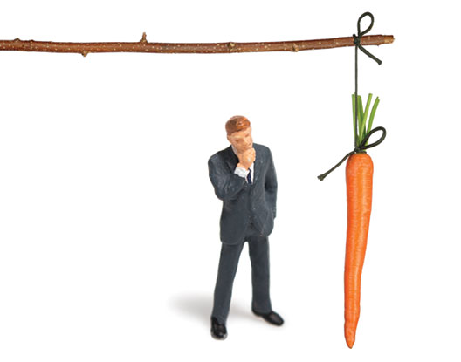
Using incentives and sanctions for behavior modification
The Carrot and the Stick: Balance positive reinforcement with punishment to reduce undesired behaviors and replace them with desired prosocial behaviors.
Incentives and Sanctions serve different, but complementary, functions. When used together, they can have synergistic effects that produce better outcomes than applying either technique alone (Marlow-2009)

Slide 4
Using incentives and sanctions for behavior modification
TRUST BUT VERIFY!
The most influential factor in modifying behavior is certainty.!
Conduct urine testing on a truly random basis, including on weekends and holidays
Community Supervision: Drug Courts that include LE/Community Corrections on their teams also tend to have better outcomes (Carey, 2008). Activities must include conducting random home contacts, verifying employment/school attendance, enforcing restrictions and monitoring compliance with probation requirements.

Slide 5
Using incentives and sanctions for behavior modification
Timing is Everything!
Go To: www.drugcourtonline.org
Doug Marlow-Timing of Supervision

Slide 6
To Be Most EFFECTIVE, incentives and sanctions need to be……..
Certain: Avoid Surprises. Ensure that the participant is educated on the response (positive/negative) to the behavior. The matrix should be in the participant handbook
Immediate: Respond immediately to each accomplishment/negative behavior so that the participant will associate the incentive or sanction with the behavior that is encouraged or discouraged
Procedural Fairness

Slide 7
Further consideration
Staying Centered: Magnitude
Targeting Behaviors
Don’t expect too much
Learned helplessness
Don’t expect too little
Habituation

Slide 8
BEFORE YOU BEGIN…………..
The team should ask the following critical questions prior to establishing a matrix:
What are the proximal and distal behaviors you are trying to shape?
Have you prioritized your target behaviors by phase?
Are the responses for addicts of a different magnitude than for abusers considering the proximal and distal target behavior goals?
Have you used available local and national resources to expand your range of consequences?
Does your list of responses reflect the importance of incentives?

Slide 9
Things to consider: Delivering responses effectively
Applying the 10 principles will enhance the probability of meaningful behavior change
Responses are in the eyes of the behavior
Sanctions should not be painful, humiliating or injurious
Responses must be of sufficient intensity
Responses should be delivered for every target behavior
Undesirable behavior must be reliably detected
Responses should be delivered immediately
Responses must be predictable and controllable
Responses may have unintentional side effects
Behavior does not change by punishment alone
The method of delivery of the response is as important as the response itself

Slide 10
BUILDING AND USING incentives and sanctions matrix
Step 1-
Begin by building a solid foundation of target behaviors. The team must consider what the target behaviors are in relation to proximal/distal behaviors.
Are they realistic to accomplish? Can the person accomplish them?
https://www.youtube.com/watch?feature=player_embedded&v=p3JPa2mvSQ4
The team should prioritize the behaviors they want to primarily shape in each phase of their program and design their incentive/sanction matrix to reflect these different priorities.

Slide 11
BUILDING AND USING incentives and sanctions matrix
Step 2
Review the National Drug Court Institute list of incentives and sanctions
Determine as a team your scope and access to resources to implement incentives and sanctions
Request feedback from graduates on what motivated their behavior change and suggestions for incentives and sanctions that would be effective

Slide 12
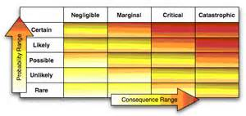
BUILDING AND USING incentives and sanctions matrix
Step 3
Utilizing the local and national resources, the team will need to develop a range of consequences for any given behavior
Determine if the responses will be delineated by Phase

Slide 13
EXAMPLE of an incentive matrix
RESPONSES TO BEHAVIOR
ACHIEVEMENTS | INCENTIVES
Attending all court appearances Negative drug test results for period of time Attendance and participation in treatment Attendance and participation in support meetings Completion of GED College enrollment and attendance Job promotion Compliance with treatment/supervision plan Voluntary Speaking Engagements Artwork, Essays, Journals Phase Advancement | Recognition and Praise by the Judge Courtroom recognition/STAR Board Certificates of achievement Buss Passes Movie/Event tickets or gift cards Reduction in Fines and Costs Decreased court appearances Phase advancement Voucher Assistance #1 on Docket of Choice Haircut/manicure/pedicure Food /Grab Box

Slide 14
Example of a sanctions matrix
CHOICES | SANCTIONS
Missed court appearances Missed appointment with probation officer Missed support meetings Violation of court order Positive drug test Missed drug test (considered a positive drug test) Tampered drug test Missed treatment Inappropriate behavior at treatment facility New DUI or felony conviction Driving while license suspended/revoked Failure to perform sanctions Noncompliance with treatment plan Dishonesty | Reprimand from the Judge Increased court appearances Increased drug testing Day Reporting to Probation, Court or facility Curfew Imposed Increase Probation Office Visits Work Release Additional community service hours Essay presented to Judge or gallery Attendance at Orientation, Graduation or docket Area/Association Restriction Placement on, GPS or SCRAM Saturday Work Program Sentence to Jail Increase contact in current phase

Slide 15
recap
Balance positive reinforcement with punishment
Considerations of imposing incentives and sanctions
Trust But Verify
Timing
Immediate
Fairness
Apply 10 principles that will enhance behavior change
Understand Target Behavior!
As a team, develop a realistic matrix

