Slide 1
Effective Evaluation to Improve Problem-solving Court Outcomes, and More!
8/21/2015
Scott Ronan
Idaho Supreme Court
Senior Manager, Problem-Solving Courts and Sentencing Alternatives

Slide 2
Collecting data and using evaluations to make programmatic changes results in better outcomes!
Who says so? NPC Research, NADCP, & Idaho Standards
What Data and What Evaluations? Utilization Report data, ISTARS/dashboard data, peer review recommendations, & Idaho Outcome Evaluations
How can you use this data to make changes?

Slide 3
Who?NPC Research
Drug Court Best Practices
(Practices Related to Significant Reductions in Recidivism and Higher Cost Savings)
-69 drug courts were included in an analysis that examined the drug court ten key components compared to outcomes
Key Component # 8-Monitoring and evaluation measure the achievement of program goals and gauge effectiveness
FINDINGS!
8.1 The results of program evaluations have led to modifications in drug court operations

Slide 4
Cont…
8.2 Review of program data and/or regular reporting of program statistics has led to modifications in drug court operations
8.3 The drug court maintains data that are critical to monitoring and evaluation in an electronic database (rather than paper files).
2008. Exploring the Key Components of Drug Courts: A Comparative Study of 18 Adult Drug Courts on Practices, Outcomes and Costs. Drug Court Peer Review-Vol VIII, Issue 1, Special Issue. “What Works” The Ten Key Components of Drug Court: Research Best Practices. Pgs. 60-66.
http://npcresearch.com/wp-content/uploads/NIJ_Cross-site_Final_Report_03082.pdf

Slide 5
NPC Research
Top Ten Practices for Reducing Recidivism
Drug Courts where internal review of the data and program statistics led to modifications in program operations had 105% greater reductions in recidivism.
The key elements to this best practice are twofold:
1) The program uses an electronic data collection and management system that allows staff to provide the Drug Court with relevant statistics on program performance and operations, which the team can use to garner insights into its performance, guide improvements, and reveal areas where training is needed.
2) The Drug Court uses the data as a basis for practical program change and continues to use it to monitor progress

Slide 6
Top Ten Practices for Cost Savings
Many of the top ten practices for reducing recidivism are the same ones that also contribute to saving costs. These findings are both in the top ten for reducing recidivism and costs!
1. Drug Courts where internal review of the data and program statistics led to modifications in program operations had 131% higher cost savings…Regularly monitoring data further provides feedback that the team can use to make necessary adjustments to meet goals in a timely and regular manner.
2. Drug Courts that had evaluations conducted by independent evaluators and used them to make modifications in Drug Court operations had 100% greater cost savings…this practice depends on the program’s willingness to make changes based on data and to continue to use data to monitor progress.
2012. Drug Court Peer Review-Vol VIII, Issue 1, Special Issue. “What Works” The Ten Key Components of Drug Court: Research Best Practices. Pgs. 25-31
http://www.ndci.org/sites/default/files/nadcp/DCR_best-practices-in-drug-courts.pdf

Slide 7
Who? NADCP Standards Vol II – X. Monitoring and Evaluation- pg.59
A. Adherence to Best Practices
B. In-Program Outcomes
C. Criminal Recidivism
D. Independent Evaluations
E. Historically Disadvantaged Groups
F. Electronic Database
G. Timely and Reliable Data Entry
H. Intent-to-Treat
I. Comparison Groups
J. Time at Risk
http://www.ndcrc.org/sites/default/files/adult_drug_court_best_practice_standards_volume_ii.pdf

Slide 8
Who? Idaho Standards & Guidelines for Effectiveness And Evaluation- Pgs. 14-15
*Only Standards are represented here. For the full list, follow the link below
5.0 EVALUATION
5.1 Specific and measurable criteria marking progress should be established and recorded in ISTARS for each drug court participant (i.e. drug testing results, compliance with program requirements, sanctions and incentives, participation in treatment, payment of fees, etc.).
5.3 Drug Courts shall utilize the ISTARS Drug Court Module to record participant information and information on participation, phase movement and graduation.
5.5 Drug courts shall provide utilization data to the Idaho Supreme Court promptly by the 10th of the month. The utilization report provides at a minimum, the number of participants active in drug court at the Revised December 12, 2011 15 start of the month, the number of new admissions to drug court during the month, the number of unsuccessful terminations and graduates during the month, and the number of participants enrolled on the last day of the month.

Slide 9
5.8 Initial drug court intake information must be obtained for each participant assessed for entry into drug court. Complete intake information must be obtained for all participants who enter drug court. This data must be entered into the ISTARS drug court module. This information is essential to evaluate the effectiveness of the Idaho Drug Courts.
5.10 A client feedback evaluation should be conducted twice-per-year by each drug court.
5.11 An annual report, The Effectiveness of Idaho Drug Courts will be presented to the Governor and the Legislature by the Idaho Drug Court Coordinating Committee, no later than the first day of the Legislative session.
5.12 Evaluation results/ recommendations should be reviewed and implemented on at least an annual basis and be used to analyze operations, modify program procedures, gauge effectiveness, change therapeutic interventions, measure and refine program goals, and make decisions about continuing or expanding the program.
http://www.isc.idaho.gov/psc/DCMHCC_Guidelines_and_Standards_Rev12-2011.pdf

Slide 10
What Data?
ISTARS data-dashboard data
Peer review recommendations
Idaho Outcome Evaluations

Slide 11
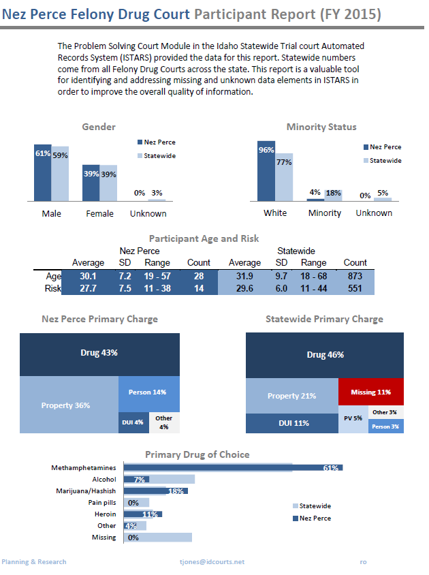
ISTARS Data Dashboard Report Sample:

Slide 12
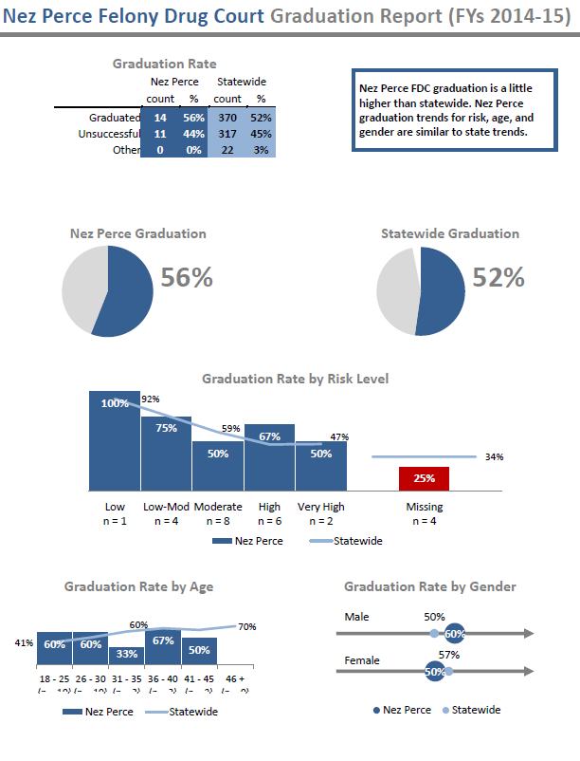

Slide 13
Peer Review Findings-strengths
Typical types of findings resulting from a peer review:
Strengths-
[1.7] Fees are required
[2.3] Candidates undergo a criminogenic risk assessment
[3.7] Treatment services offered include: a cognitive, behavioral model and addresses criminal thinking
Participants spend a minimum of 3 minutes with the Judge per court appearance on average
[4.21] Program protects against unauthorized sharing of sensitive participant information
In order to graduate, participants must have a sober housing environment.

Slide 14
Peer Review-Areas for improvement-
Practices Based on Idaho Standards and Guidelines:
[1.8] Participant pays for treatment, but on a sliding scale
[5.10] Client feedback obtained twice per year using statewide format; data used by team to consider changes in court operations.
[5.12] Program evaluation results/recommendations reviewed and implemented, used to make program modifications
[6.4] Trial Court Administrator in each District convenes an annual meeting to discuss district-wide issues affecting program operations and outcomes.
[6.6]Judge convenes team meeting at least 2 times per year for training for entire team (Coordinator assesses training needs and arranges training)
Practices Based on NPC Research Findings:
Estimate time between arrest and referral is 50 days or less
Program offers health care and/or dental care
Team members are given a copy of the guidelines for sanctions
New hires to the drug court complete formal training/orientation

Slide 15
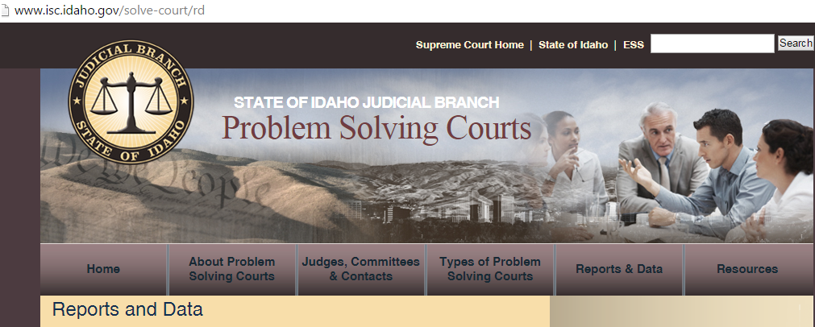

Slide 16
FDC outcome Evaluation Key Findings:
Greater use of jail as a sanction = higher risk of recidivism.
Higher levels of family engagement = lower risk of recidivism.
Offenders in courts that reduce hearings in later phases have a 30% lower risk of recidivating
One additional hour individual treatment
2% decrease in risk of recidivism.
One additional hour recovery support services
3% decrease in risk of recidivism.
A decrease in treatment in later phases increases the likelihood of graduation.

Slide 17
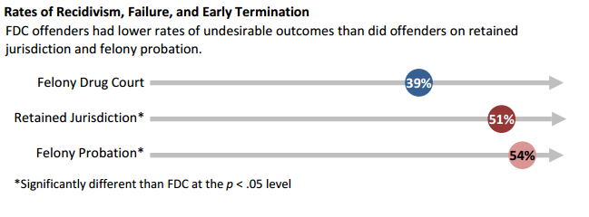

Slide 18
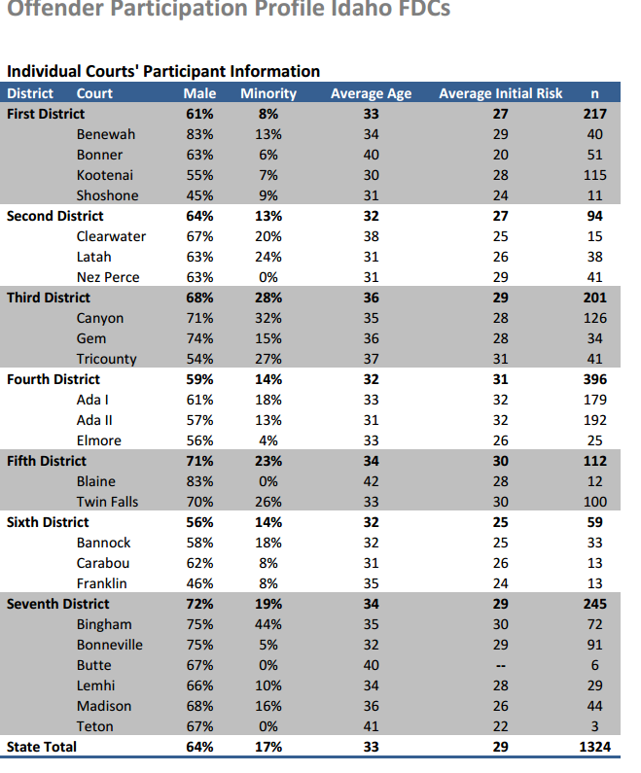

Slide 19
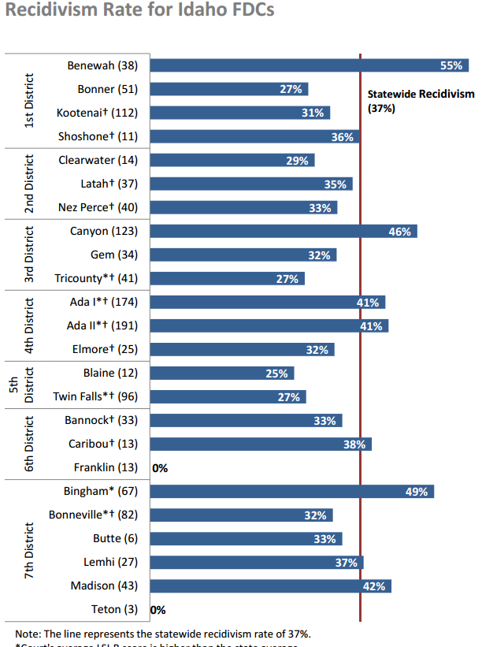

Slide 20
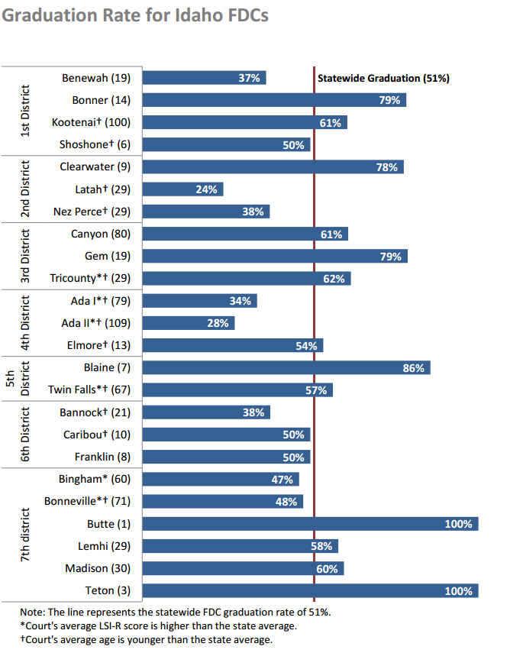

Slide 21
How can you use this data to make changes?
Review available information
Meetings not Staffings
Discuss practices/outcomes with team
Set Goals
Periodic check-ins for follow-up
Ask! advice, assistance, analysis, etc.
Achieve Goals!

Slide 22
Remember!
Better outcomes = making changes based on data

Slide 23
Questions?

