Slide 1
Drug Courts: Some Answers to Our Burning Questions
Top 10 Drug Court Best Practices and More: What the Research Tells Us
How Drug Court Practices Impact Recidivism and Costs
NADCP
May 2008
Shannon Carey, Ph.D.
August 2014
Notes:
Shannon
Who was at the plenary yesterday?
Did any of you attend our presentation last year?

Slide 2
Top 10 best practices, plus some bonus practices
Overview
What we know about drug court outcomes
What works
Notes:
Shannon

Slide 3
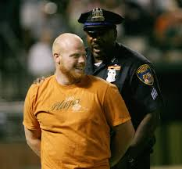
Recidivism
What We Already Know
Drug Courts reduce recidivism
Recidivism is decreased up to 14 years after participation
Average reduction is about 18%
Some courts more than 60%
Notes:
Shannon

Slide 4
Standards of Proof
Science
Replicated experiments or
quasi-experiments (meta-analyses)
Target population
Best practices
Beyond a Reasonable Doubt
Law
> 95%
Replicated experiments or
quasi-experiments (meta-analyses)
Clear & Convincing Evidence
Adult Drug Courts
Experiment or quasi-experiment
Preponderance of the Evidence
≈ 75%
Pre-to-post studies
Mixed results
51%
Probable Cause
Analogies
Anecdotes
Reasonable Suspicion
≈ 25%

Slide 5
Variable Effects
6%
16%
Most drug courts work
78%
(Wilson et al., 2006; Lowenkamp et al., 2005; Shaffer, 2006)

Slide 6
Variable Effects
Some don’t work
6%
16%
78%
(Wilson et al., 2006; Lowenkamp et al., 2005; Shaffer, 2006)

Slide 7
Variable Effects
Let’s do the math:
2,838 drug courts (as of 06/30/2013)
x .06
= 170 harmful drug courts!
Some are harmful!
6%
16%
another 454 ineffective drug courts
78%
(Wilson et al., 2006; Lowenkamp et al., 2005; Shaffer, 2006)

Slide 8
What is Working?
Notes:
Juliette

Slide 9
Including California, Guam, Idaho, Indiana, Florida, Michigan, Maryland, Missouri, Minnesota, New York, Nevada, Oregon and Vermont
What is Working?
In the past 15 years NPC has completed
over 175 drug court evaluations and
research studies nationally
Adult, Juvenile, DWI/DUI and Family Treatment (Dependency) Drug Courts
Notes:
Shannon

Slide 10
What is Working?
Looked at 101 drug courts around the nation (detailed process studies/10 KC)
69 included recidivism and cost evaluations
In total, this study included 32,719 individuals (16,317 drug court participants and 16,402 comparison group members).
Average reduction in recidivism 25%
About 23% of these had either no effect or worse recidivism and costs
Notes:
Juliette

Slide 11
Found over 50 practices that were related to significantly lower recidivism or lower costs or both
What is Working?
Translating the 10KC into practical application – specific drug court practices
What are the best drug courts doing?
NADCP Best Practice Standards
Volume I – July 2013
Volume II – Fall 2014
Notes:
Juliette

Slide 12
Drug Court Top 10
What is Working?
Top 10 Best Practices for Reducing Recidivism
Top 10 Best Practices for Reducing Cost (Increasing Cost Savings)
Notes:
Juliette

Slide 13
Drug Court Top 10 *Recidivism*
10. The results of program evaluations have led to modifications in drug court operations
Notes:
Juliette

Slide 14
10. Drug Courts that used program evaluations to make modifications in drug court operations had 85% greater reductions in recidivism
Note: Difference is significant at p<.10

Slide 15
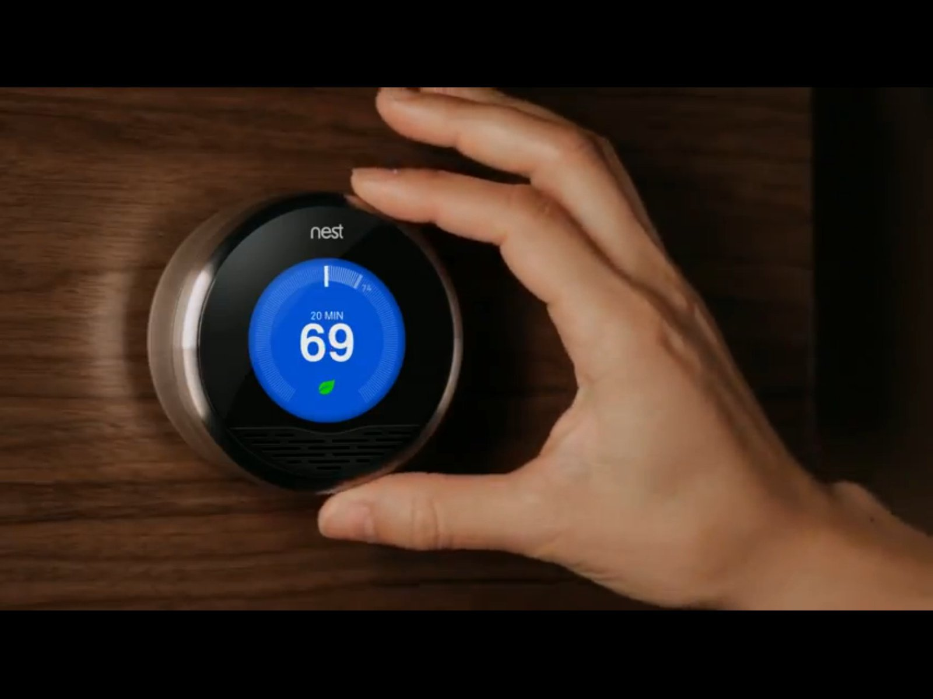
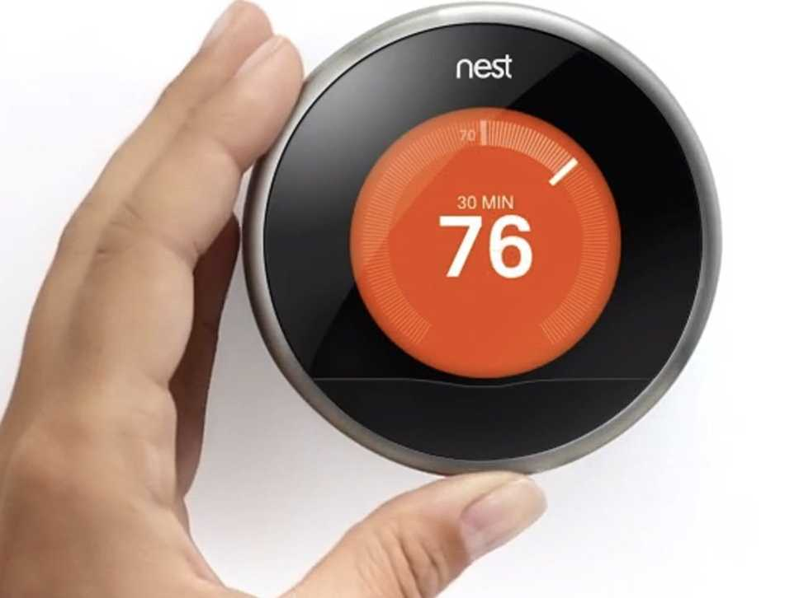
10. Drug Courts that used program evaluations to make modifications in drug court operations had 85% greater reductions in recidivism

Slide 16
Drug Court Top 10 *Recidivism*
10. The results of program evaluations have led to modifications in drug court operations
9. Law Enforcement is a member of the drug court team
Notes:
Juliette

Slide 17
9. Drug Courts where (non-Probation) Law Enforcement is a member of the drug court team had 88% greater reductions in recidivism
Note: Difference is significant at p<.05

Slide 18
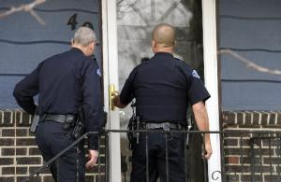
9. Drug Courts where (non-Probation) Law Enforcement is a member of the drug court team had 88% greater reductions in recidivism

Slide 19
Drug Court Top 10 *Recidivism*
10. The results of program evaluations have led to modifications in drug court operations
9. Law enforcement is a member of the drug court team
8. Drug court allows non-drug charges
Notes:
Juliette

Slide 20
8. Drug Courts That Allow Non-Drug Charges had 95% greater reductions in recidivism
Note: Difference is significant at p<.05

Slide 21
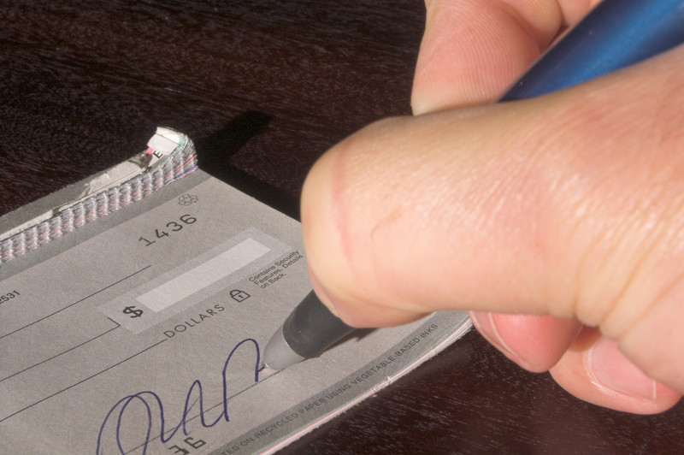
8. Drug Courts That Allow Non-Drug Charges had 95% greater reductions in recidivism

Slide 22
Drug Court Top 10 *Recidivism*
10. The results of program evaluations have led to modifications in drug court operations
9. Law Enforcement is a member of the drug court team
8. Drug Court allows non-drug charges
7. A representative from treatment attends court sessions
Notes:
Juliette

Slide 23
7. Drug Courts Where a Treatment Representative Attends Court Hearings had 100% greater reductions in recidivism
Note: Difference is significant at p<.10

Slide 24
7. Drug Courts Where a Treatment Representative Attends Court Hearings had 100% greater reductions in recidivism

Slide 25
Drug Court Top 10 *Recidivism*
10. The results of program evaluations have led to modifications in drug court operations
9. Law Enforcement is a member of the drug court team
8. Drug Court allows non-drug charges
7. A representative from treatment attends court sessions
6. Review of the data/program stats has led to modifications in drug court operations
Notes:
Juliette

Slide 26
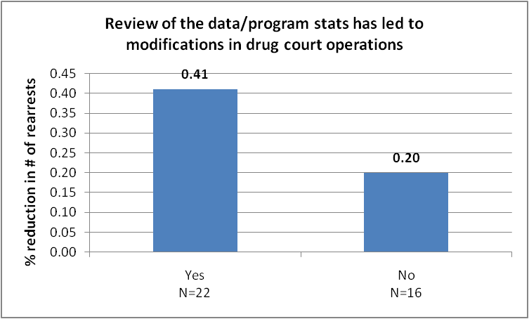
6. Drug Courts Where Review of the Data and/or Program Statistics Led to Modifications in Program Operations had 105% greater reductions in recidivism
Note: Difference is significant at p<.05

Slide 27
6. Drug Courts Where Review of the Data and/or Program Statistics Led to Modifications in Program Operations had 105% greater reductions in recidivism

Slide 28
Drug Court Top 10 *Recidivism*
5. A representative from treatment attends drug court team meetings (staffings)
Notes:
Juliette

Slide 29
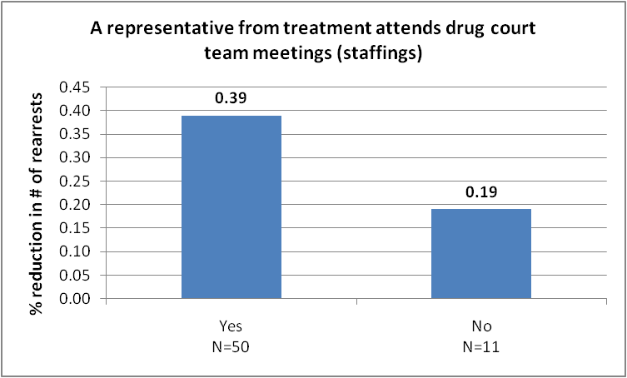
5. Drug Courts Where a Representative From Treatment Attends Drug Court Team Meetings (Staffings) had 105% greater reductions in recidivism
Note: Difference is significant at p<.10

Slide 30
5. Drug Courts Where a Representative From Treatment Attends Drug Court Team Meetings (Staffings) had 105% greater reductions in recidivism

Slide 31
Drug Court Top 10 *Recidivism*
5. A representative from treatment attends drug court team meetings (staffings)
4. Treatment communicates with court via email
Notes:
Juliette

Slide 32
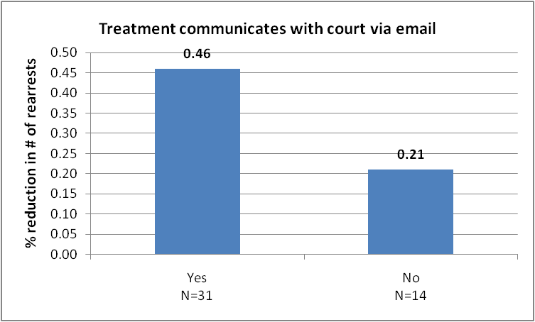
4. Drug Courts Where Treatment Communicates with
the Court via Email had 119% greater reductions in recidivism
Note: Difference is significant at p<.10

Slide 33
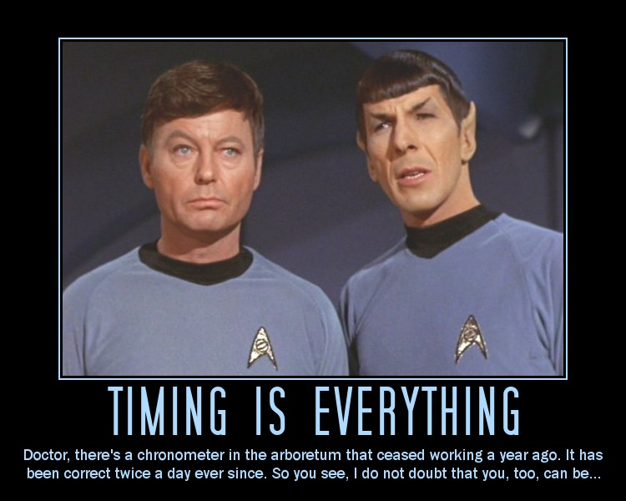
4. Drug Courts Where Treatment Communicates with
the Court via Email had 119% greater reductions in recidivism

Slide 34
Drug Court Top 10 *Recidivism*
5. A representative from treatment attends drug court team meetings (staffings)
4. Treatment communicates with court via email
3. Judge spends an average of 3 minutes or greater per participant during status review hearings
Notes:
Juliette

Slide 35
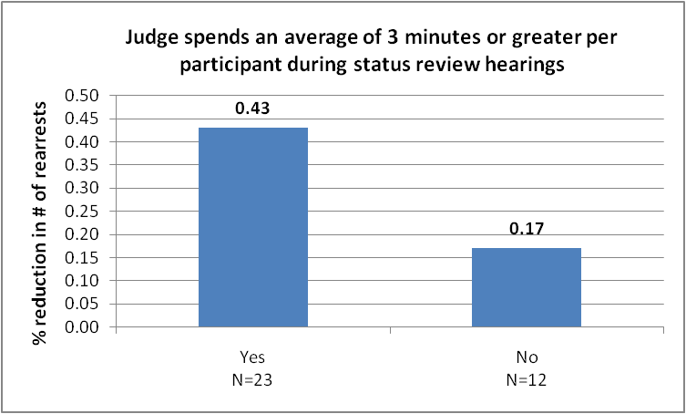
3. Drug Courts Where the Judge Spends an Average of 3
Minutes or Greater per Participant During Court Hearings
had 153% greater reductions in recidivism
Note: Difference is significant at p<.05

Slide 36
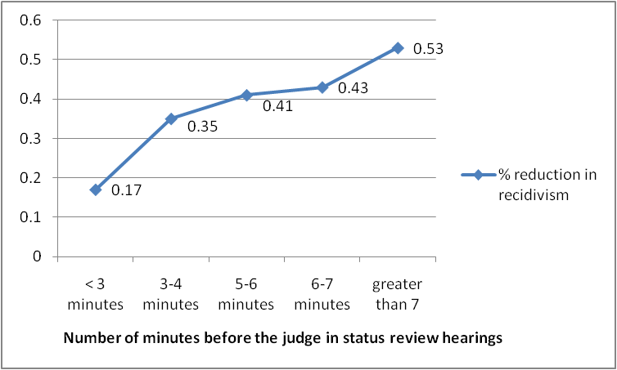
Drug Courts Where the Judge Spends an Average of 3 Minutes or Greater per Participant During Court Hearings had 153% greater reductions in recidivism
Note: Difference is significant at p<.05

Slide 37
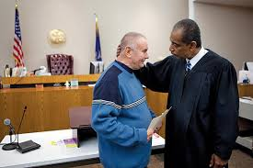
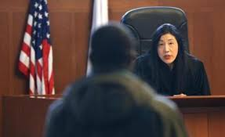
3. Drug Courts Where the Judge Spends an Average of 3
Minutes or Greater per Participant During Court Hearings
had 153% greater reductions in recidivism

Slide 38
Drug Court Top 10 *Recidivism*
5. A representative from treatment attends drug court team meetings (staffings)
4. Treatment communicates with court via email
3. Judge spends an average of 3 minutes or greater per participant during status review hearings
2. Participants are expected to have greater than 90 days clean (negative drug tests) before graduation
Notes:
Juliette

Slide 39
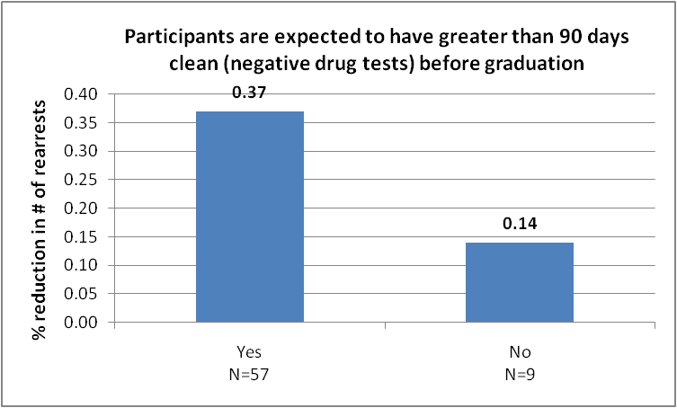
2. Drug Courts Where Participants are expected to have greater than 90 days clean (negative drug tests) before graduation
Had 164% greater reductions in recidivism
Note: Difference is significant at p<.15 (Trend)

Slide 40
2. Drug Courts Where Participants are expected to have greater than 90 days clean (negative drug tests) before graduation
Had 164% greater reductions in recidivism
Note: Difference is significant at p<.15 (Trend)

Slide 41
Drug Court Top 10 *Recidivism*
5. A representative from treatment attends drug court team meetings (staffings)
4. Treatment communicates with court via email
3. Judge spends an average of 3 minutes or greater per participant during status review hearings
2. Participants are expected to have greater than 90 days clean (negative drug tests) before graduation
1. Program caseload (number of active participants) is less than 125
Notes:
Juliette

Slide 42
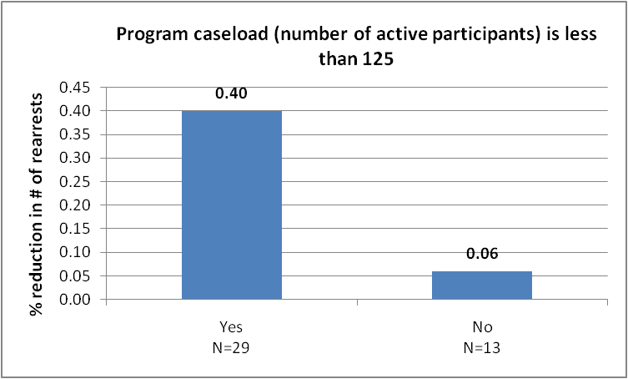
1. Drug Courts with a Program Caseload (Number of Active Participants) of less than 125 had 567% greater reductions in recidivism
Note: Difference is significant at p<.05

Slide 43
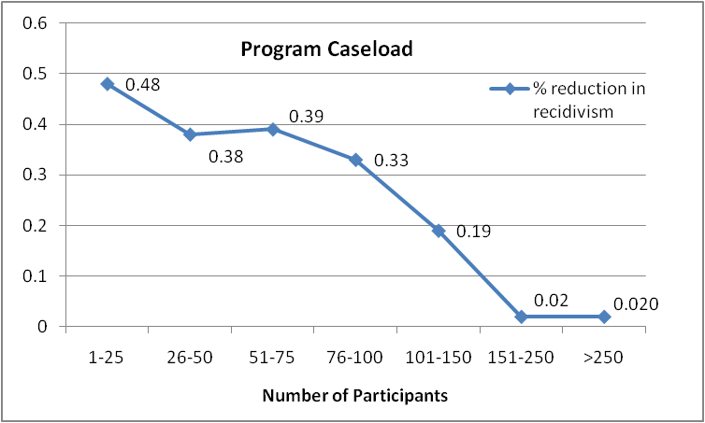
1. Drug Courts with a Program Caseload (Number of Active Participants) of less than 125 had 567% greater reductions in recidivism
Note: Difference is significant at p<.05

Slide 44
1. Drug Courts with a Program Caseload (Number of Active Participants) of less than 125 had 567% greater reductions in recidivism
In larger drug courts:
The Judge spent less time per participant in court (nearly half the time)
Tx and LE were less likely to attend staffings
(All team members were less likely to attend staffings)
Tx and LE was were less likely to attend court hearings
Tx was less likely to communicate with the court through email
Greater number of Tx agencies (8 vs 3)
Drug tests were less frequent
Team members were less likely to be trained
*All findings above were statistically significant (p < .05)

Slide 45
When drug courts hit 125 participants or greater they should ensure they have the ability to continue to deliver best practices:
The Judge should continue to spend at least 3 minutes per participant during status review hearings
All team members must continue to attend all status hearings (including treatment and law enforcement)
All team members must continue to attend all staffings (including treatment and law enforcement)
Tx must continue to communicate with the court through email
Coordinate and overseen treatment with a single agency or provider (particularly if there are multiple agencies providing treatment)
Drug tests must continue at least two times per week
Team members must receiver regular training in the drug court model and related topics

Slide 46
Drug Court Top 10 *Cost Savings*
10. Law enforcement attends court sessions
Notes:
Juliette

Slide 47
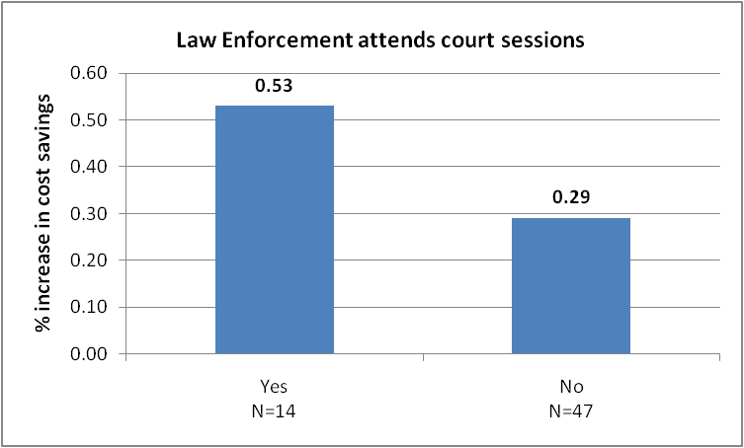
10. Drug Courts Where Law Enforcement attends
court sessions had 64% Higher Cost Savings
Note: Difference is significant at p<.05

Slide 48
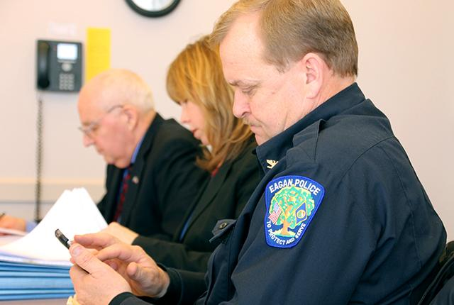
10. Drug Courts Where Law Enforcement attends
court sessions had 64% Higher Cost Savings

Slide 49
Drug Court Top 10 *Cost Savings*
10. Law Enforcement attends court sessions
9. In the first phase of drug court, drug tests are collected at least two times per week
Notes:
Juliette

Slide 50
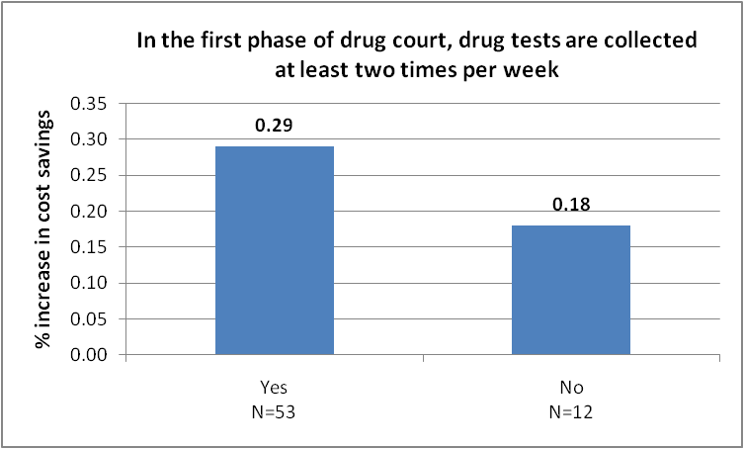
9. Drug Courts Where Drug Tests are Collected at Least Two Times per Week In the First Phase had 68% Higher Cost Savings
Note: Difference is significant at p<.15 (Trend)

Slide 51
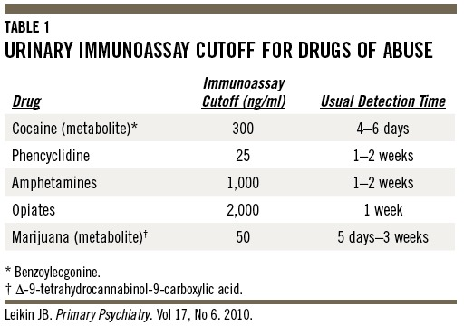
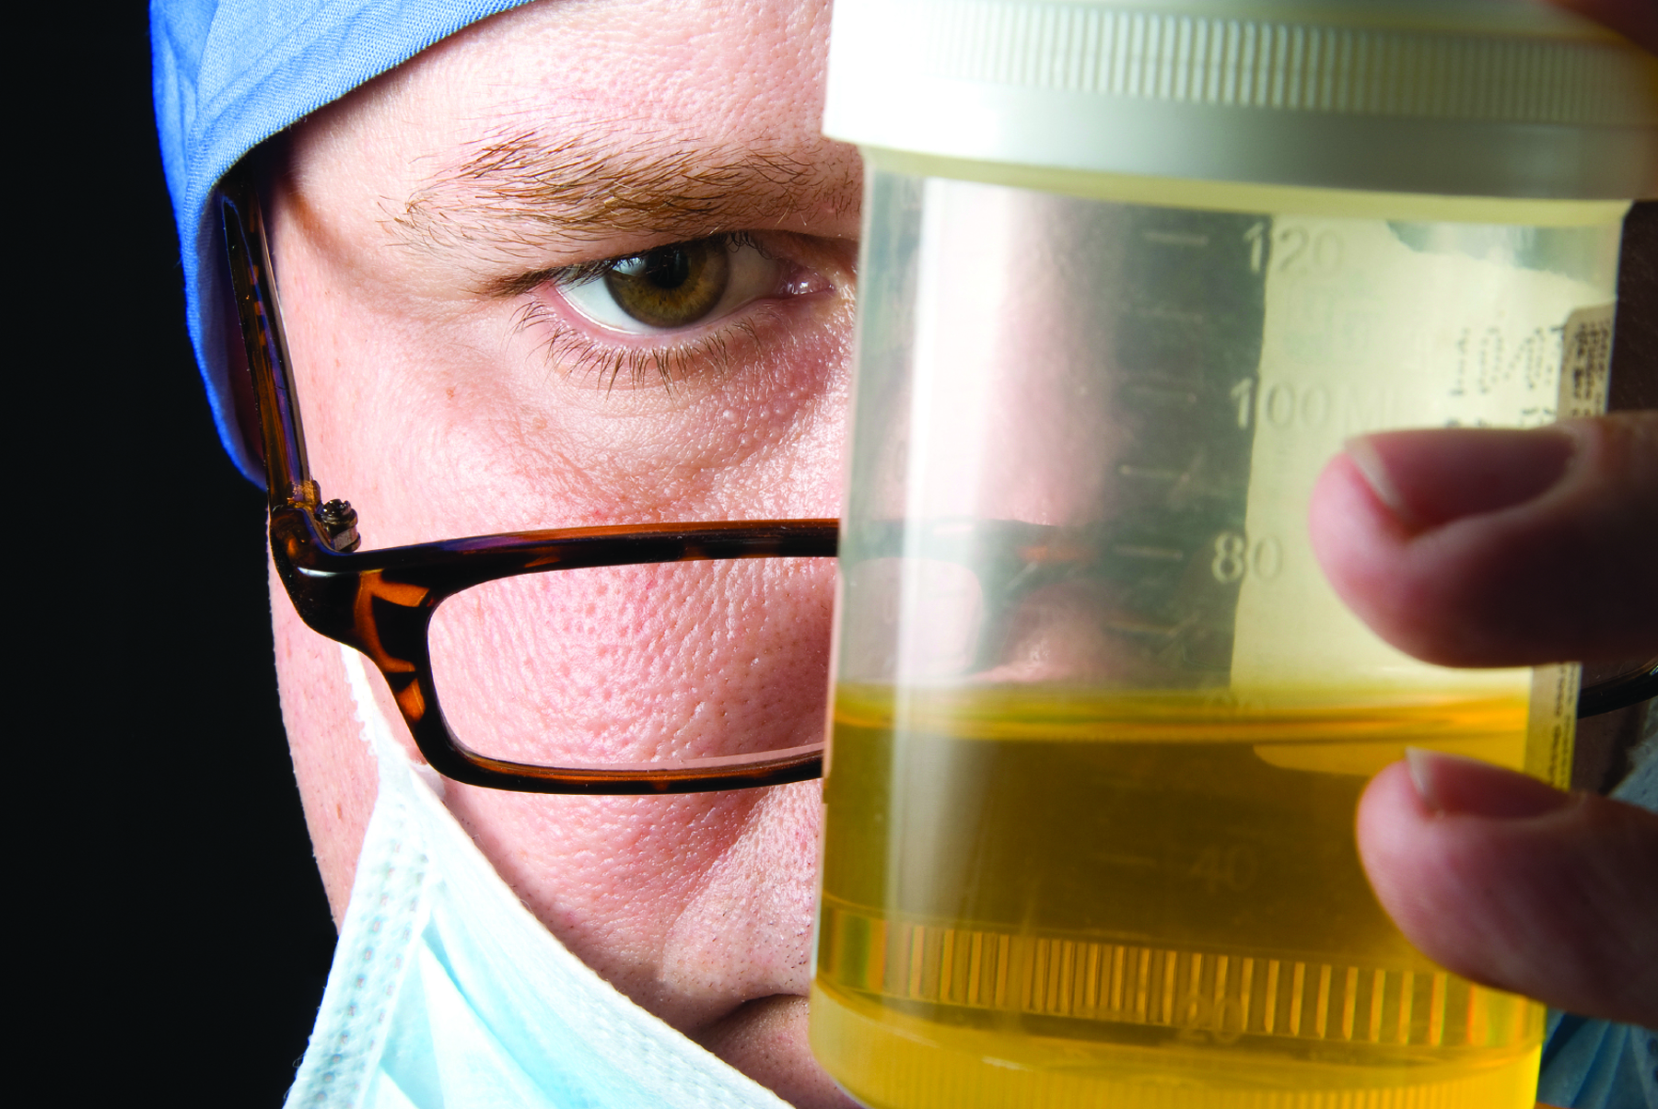
9. Drug Courts Where Drug Tests are Collected at Least Two Times per Week had 68% Higher Cost Savings

Slide 52
Drug Court Top 10 *Cost Savings*
10. Law Enforcement attends court sessions
9. In the first phase of drug court, drug tests are collected at least two times per week
8. Drug test results are back in 48 hours or less
Notes:
Juliette

Slide 53
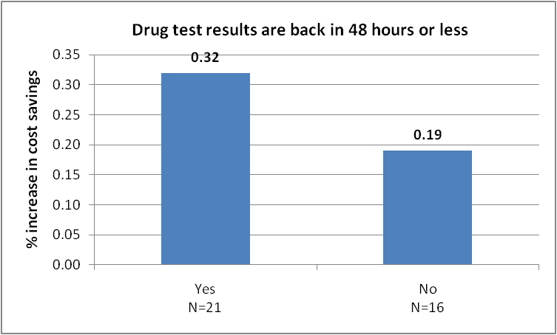
8. Drug Courts Where Drug Test Results are Back in 48 Hours or Less had 68% Higher Cost Savings
Note: Difference is significant at p<.05

Slide 54
8. Drug Courts Where Drug Test Results are Back in 48 Hours or Less had 68% Higher Cost Savings

Slide 55
Drug Court Top 10 *Cost Savings*
10. Law Enforcement attends court sessions
9. In the first phase of drug court, drug tests are collected at least two times per week
8. Drug test results are back in 48 hours or less
7. Team members are given a copy of the guidelines for sanctions
Notes:
Juliette

Slide 56
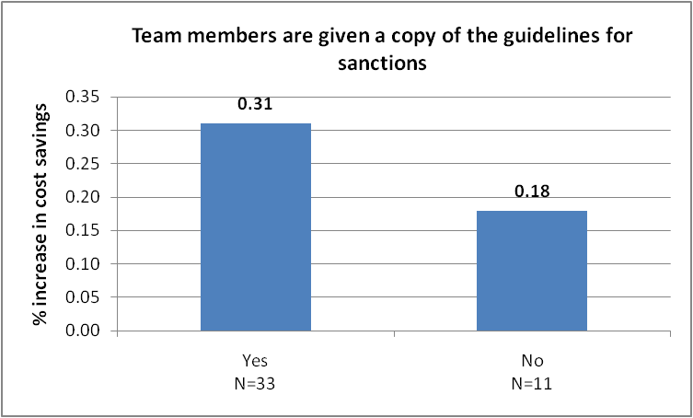
7. Drug Courts Where Team Members are Given a Copy of the Guidelines for Sanctions had 72% Higher Cost Savings
Note: Difference is significant at p<.15 (Trend)

Slide 57
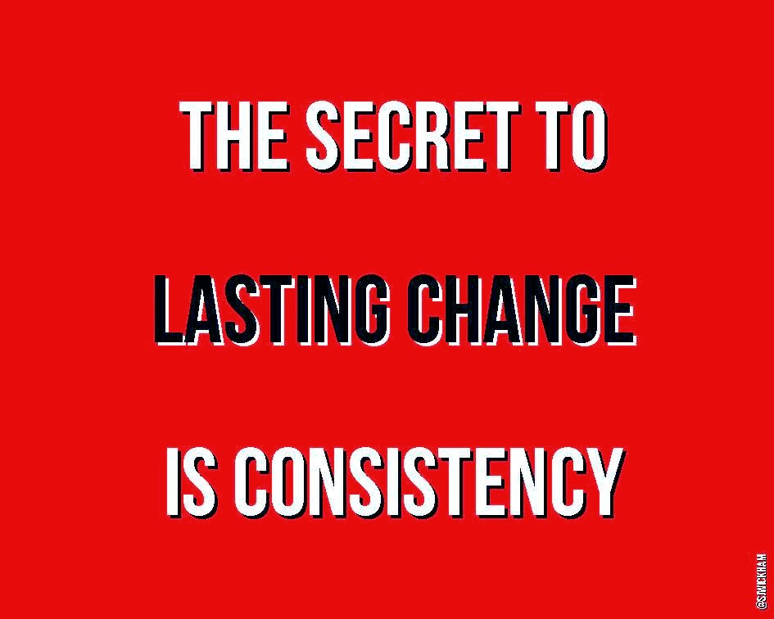
7. Drug Courts Where Team Members are Given a Copy of the Guidelines for Sanctions had 72% Higher Cost Savings

Slide 58
Drug Court Top 10 *Cost Savings*
10. Law Enforcement attends court sessions
9. In the first phase of drug court, drug tests are collected at least two times per week
8. Drug test results are back in 48 hours or less
7. Team members are given a copy of the guidelines for sanctions
6. A representative from treatment attends court sessions
Notes:
Juliette

Slide 59
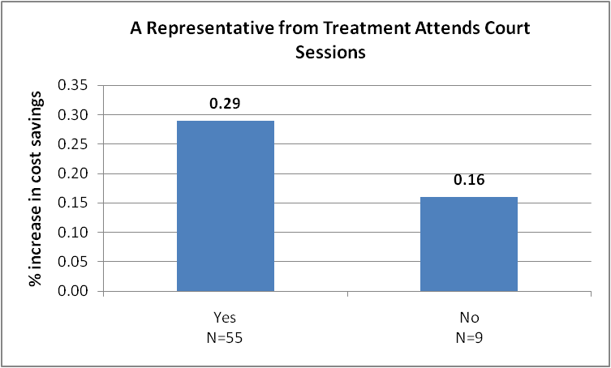
6. Drug Courts Where a Representative from Treatment Attends Court Sessions had 81% Higher Cost Savings
Note: Difference is significant at p<.10

Slide 60
6. Drug Courts Where a Representative from Treatment Attends Court Sessions had 81% Higher Cost Savings

Slide 61
Drug Court Top 10 *Cost Savings*
5. In order to graduate participants must have a job or be in school
Notes:
Juliette

Slide 62
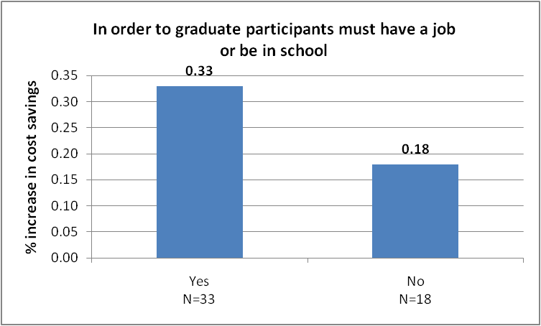
Drug Courts Where in Order to Graduate Participants Must Have a Job or be in School had 83% Higher Cost Savings
Note: Difference is significant at p<.05

Slide 63
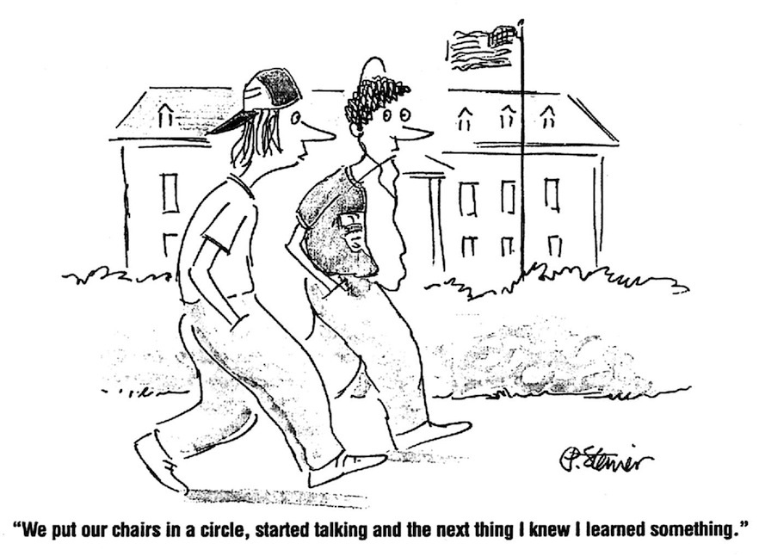
Drug Courts Where in Order to Graduate Participants Must Have a Job or be in School had 83% Higher Cost Savings

Slide 64
Drug Court Top 10 *Cost Savings*
5. In order to graduate participants must have a job or be in school
4. The defense attorney attends drug court team meetings (staffings)
Notes:
Juliette

Slide 65
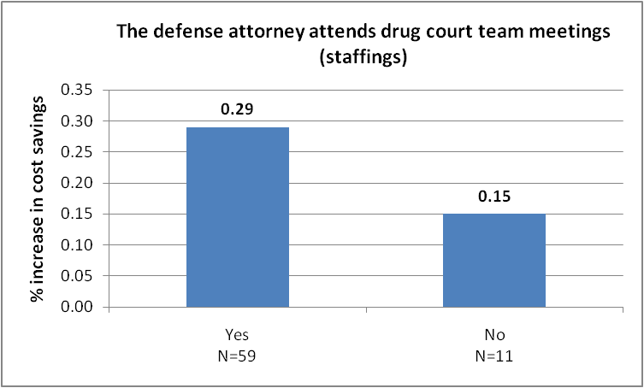
4. Drug Courts Where the Defense Attorney Attends Drug Court Team Meetings (Staffings) had 93% Higher Cost Savings
Note: Difference is significant at p<.05

Slide 66
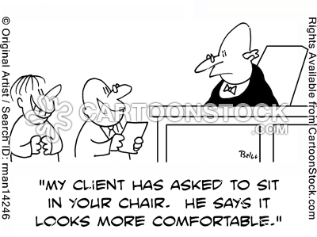
4. Drug Courts Where the Defense Attorney Attends Drug Court Team Meetings (Staffings) had 93% Higher Cost Savings

Slide 67
Drug Court Top 10 *Cost Savings*
5. In order to graduate participants must have a job or be in school
4. The defense attorney attends drug court team meetings (staffings)
3. Sanctions are imposed immediately after non-compliant behavior (e.g., in advance of a client's regularly scheduled court hearing)
Notes:
Juliette

Slide 68
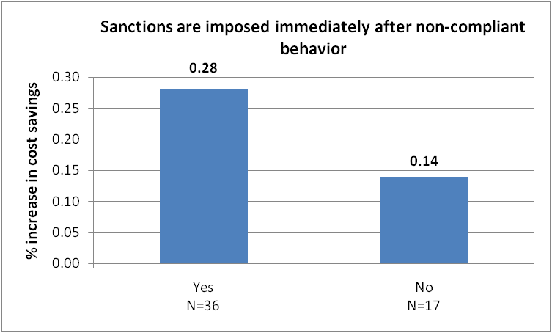
3. Drug Courts Where Sanctions Are Imposed Immediately After Non-compliant Behavior had 100% Higher Cost Savings
Note: Difference is significant at p<.05

Slide 69
3. Drug Courts Where Sanctions Are Imposed Immediately After Non-compliant Behavior had 100% Higher Cost Savings

Slide 70
Drug Court Top 10 *Cost Savings*
5. In order to graduate participants must have a job or be in school
4. The defense attorney attends drug court team meetings (staffings)
3. Sanctions are imposed immediately after non-compliant behavior (e.g., in advance of a client's regularly scheduled court hearing)
2. The results of program evaluations have led to modifications in drug court operations
Notes:
Juliette

Slide 71
2. Drug Courts Where The Results Of Program Evaluations
Have Led to Modifications In Drug Court Operations had 100% Higher Cost Savings
Note: Difference is significant at p<.05

Slide 72
2. Drug Courts Where The Results Of Program Evaluations
Have Led to Modifications In Drug Court Operations had 100% Higher Cost Savings

Slide 73
Drug Court Top 10 *Cost Savings*
5. In order to graduate participants must have a job or be in school
4. The defense attorney attends drug court team meetings (staffings)
3. Sanctions are imposed immediately after non-compliant behavior (e.g., in advance of a client's regularly scheduled court hearing)
2. The results of program evaluations have led to modifications in drug court operations
1. Review of the data and stats has led to modifications in drug court operations
Notes:
Juliette

Slide 74
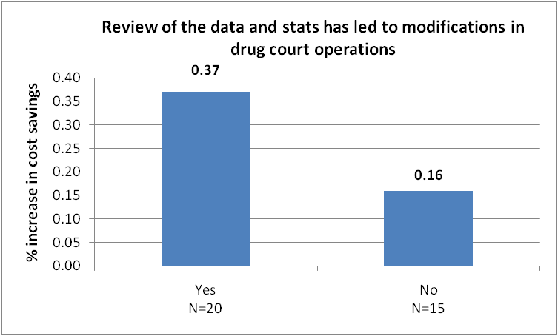
1. Drug Courts Where Review of The Data and Stats Has Led to Modifications in Drug Court Operations had 131% Higher Cost Savings
Note: Difference is significant at p<.05

Slide 75
1. Drug Courts Where Review of The Data and Stats Has Led to Modifications in Drug Court Operations had 131% Higher Cost Savings

Slide 76
Additional Best Practices of Particular Interest
Notes:
Juliette

Slide 77
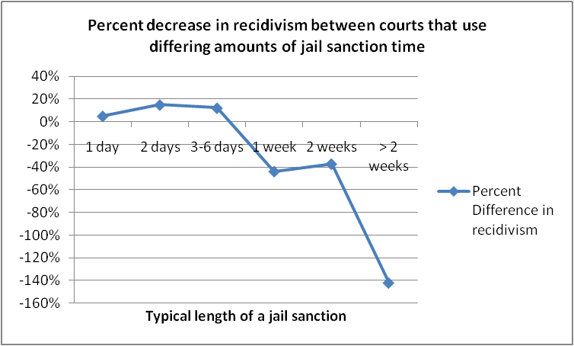
Courts that use jail greater than 6 days have worse (higher) recidivism

Slide 78
More jail time is related to higher costs
Savings
Loss

Slide 79
Drug Courts that accepted participants with prior violence had equal reductions in recidivism
Note: Difference is NOT significant

Slide 80
Drug Courts where sanctions were imposed in advance of a regularly scheduled court hearing had double the cost savings
Note: Difference is significant at p<.05

Slide 81
Drug Courts where the minimum length of the program was 12 months or more had
57% greater reductions in recidivism

Slide 82
Drug courts that offer parenting classes had
68% greater reductions in recidivism and
52% greater cost savings
True in adult, family, juvenile

Slide 83
Drug courts where the Judge attends staffings had 3.5 times greater reductions in recidivism
Note: Difference is significant at p<.05

Slide 84
Drug Courts where all team members attended staffings had 50% greater reductions in recidivism
Note : “Team Members” = Judge, Both Attorneys, Treatment Provider, Coordinator, Probation

Slide 85
Themes in the Top 10
Multidisciplinary Team:
Teams Sink or Swim Together
Relationships Matter
Case management and Supervision: Incentive and sanction guidelines/drug testing
Structure, Consistency and Accountability
Setting the program and participants up for success (Targeting)
Data and Evaluation:
Continuous Program Improvement Leads to Positive Outcomes
Notes:
Teams Sink or Swim Together—A holistic approach works. Having more people at the table collaborating pays off. Everyone brings value and the investment is worth the effort and cost. This result may be a function of communication. These data strongly make a case that all key players (e.g., judge, coordinator, treatment representative, prosecutor, defense attorney, law enforcement representative) should be members of the Drug Court team and be present both at status hearings and at staffing meetings.
Relationships Matter—Having teams that get together and work together, having fewer providers (which promotes more individual relationships and communication) and fewer participants (so that the team and judge know everyone), and ensuring participants get at least three minutes on average of the judge’s attention at each review session all help create an effective program.
Wraparound and Habilitation Services Are Key—Drug Court programs that focus on providing participant supports have better outcomes. Programs with such wraparound services avoid rearrests and save taxpayer money in the long run when they address participant needs such as relapse prevention, gender-specific services, mental health treatment, parenting classes, family counseling, anger management classes, health and dental services, and residential care.
Structure and Consistency Are Crucial—Practices that demonstrate this theme include having written guidelines for sanctions, guidelines on the number of individual treatment sessions, drug test results within forty-eight hours, drug testing at least twice per week, status reviews every other week, immediate sanctions (including those that occur outside of court and thus happen more swiftly), and a program designed to take at least twelve months. These factors ensure that participants are learning about structure, accountability, safety, and dependability.
Participants Must Be Set Up for Success—Participants should be stable before leaving the program. Best practices within this theme include requiring that participants have a job or be in school, have at least ninety days clean, have participated in the program at least twelve months, have sober housing, and have paid their fees all before they can graduate. If these practices are in place, participants should be ready to set their own goals and succeed in their lives.
Continuous Program Improvement Leads to Positive Outcomes— Programs that collect and use data, seek out training, acquire the support and insights of experts (including evaluators), and use the data and expert feedback to make ongoing adjustments to enhance practices see improvements in outcomes. These results demonstrate that Drug Courts that develop practices that focus on understanding and improving program performance have better outcomes than those that do not.
The Drug Court Model Is Effective with Difficult Populations—Drug Courts work for a wide range of populations and for participants who are seen as difficult to change and serve. These findings show that an offender’s criminal justice status (or mental health status) should not be a barrier. It does not matter whether a program’s population is only pre-adjudication, only post--adjudication, or a mix of both. Nor does it matter whether participants have violent histories or not, or whether they have misdemeanors or felonies. The focus is on treatment and consistent supervision. These results suggest that Drug Courts can successfully include a wide variety of offender populations.
Perhaps the most overarching theme is a picture of Drug Courts that are well organized. These programs have teams that are engaged in program activities and are collaborating, think through their program and clearly communicate expectations to staff and participants, and are dedicated to program improvement. These Drug Courts are the most effective in helping participants recover their futures, reducing participant recidivism, decreasing crime, and saving taxpayer money.

Slide 86
Questions?
Team work http://www.youtube.com/watch?v=1qzzYrCTKuk&list=PL9D705FDAB6D57578
Notes:
Juliette

Slide 87
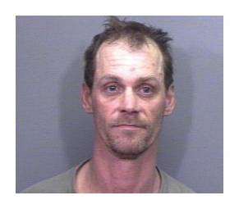
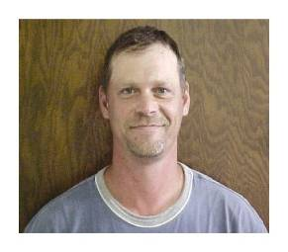
Conclusion:
Before DC
After DC
Notes:
Shannon
So, given what we know about methamphetamine, what are some of the implications for Drug Court operations?
(Pause for people’s input)

Slide 88
Contact Information
Shannon Carey, Ph.D.
carey@npcresearch.com
www.npcresearch.com
Notes:
Shannon

Slide 89
Acknowledgements Thank you to the judges, coordinators and staff at numerous drug courts who welcomed us to their program, answered our un-ending questions and helped us find and collect mountains of data!

