Slide 1
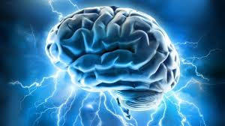
Responding to Traumatic Brain Injury
Jamie Champion, Ph.D., Clinical Neuropsychologist
Brienne Dyer, Psy.D., Clinical Neuropsychologist
Boise VA Medical Center

Slide 2
Outline
Review challenging cognitive, behavioral, and personality issues associated with TBI
Discuss management strategies
Vignette
Problem-solve your real life examples

Slide 3
Vignette
Mr. B- 32 year old male with history of ADHD, multiple mild TBIs (concussions), and methamphetamine and alcohol abuse. Presents as anxious, agitated, scattered, impatient, fidgety. Has trouble focusing, following through, managing time. Often misses appointments then becomes frantic in attempts to make up (e.g., may show up unannounced). Struggles to keep up with regimented schedule and feels like others are setting him up for failure. He often uses curse words and had a hard time controlling his temper.
How can we help him be successful in the program?

Slide 4
Cognitive Issues
Attention
Speed of processing
Learning and Memory
Executive Functioning (higher order organization and problem solving skills)
Notes:
Examples of Challenging Cognitive Issues

Slide 5
Cognitive Management Strategies
Attention and Speed of Processing
Focus and refocus person’s attention as needed
Restructure environment to reduce distractors
Slow things down

Slide 6
Cognitive Management Strategies
Learning and Memory
Have individual repeat what was said, write notes
Provide material in multiple formats (visual, verbal, hands on)
Provide frequent reminders
Have individual use external cues (planner, cell phone reminders, alarms)
Notes:
Repetition and rehearsal

Slide 7
Cognitive Management Strategies
Organization and Problem Solving Skills
Routinize daily activities
Use checklists
Implement structure
Use external aids to enhance organization
Help the individual plan ahead and problem solve difficulties that may occur

Slide 8
Behavioral Issues
Impulsivity
Disinhibition
Difficulty attending to social cues
Planning
Judgment
Notes:
Examples of these issues

Slide 9
Behavioral Management Strategies
Reinforce desired behaviors, ignore undesired
Remain calm
Do not challenge person
Validate emotions
Be explicit
Help individual learn from past mistakes in decision-making

Slide 10
Other Issues
Preexisting Personality Issues that Might Complicate TBI
Style: Manipulative, habitually disregards/breaks rules, aggressive, indifferent to effect on others
Strategy: Firm rules, consequences. Need to check on everything they say, monitor
Style: Submissive, clinging behavior. Needs frequent reassurance, goes to excessive lengths to obtain support
Strategy: Frequent brief contacts with problem solving. Be supportive but encourage independent, solution focused thinking

Slide 11
Other issues
Preexisting Personality Issues that Might Complicate TBI
Style: Grandiose sense of self-importance, sense of entitlement (unreasonable expectations of especially favorable treatment or automatic compliance with his/her expectations), lacks empathy about how behaviors affect others.
Strategy: Comment on the problems/attitudes in a supportive manner . Encourage more realistic views of themselves, the situation, and their expectations.
Style: Emotionally labile, impulsive, alternate between needy and angry, mood is reactive and variable
Strategy: Stay calm, do not react to their internal dyscontrol, focus on problem-solving and not chaos, acknowledge feelings but redirect to behaviors/desired outcomes, simplify – break into chunks

Slide 12
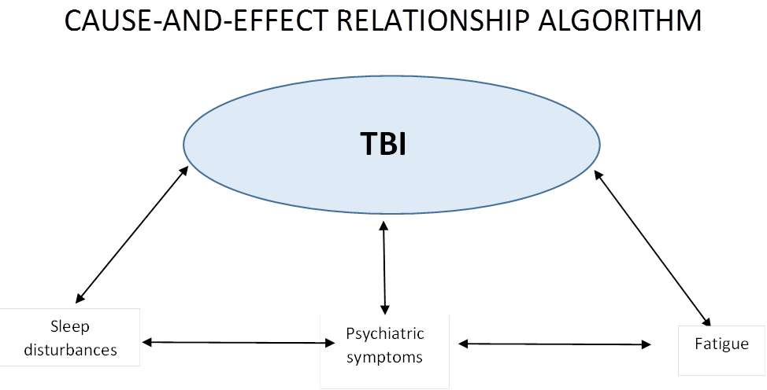
Other Issues
Fatigue and sleep disturbance are two common disabling symptoms that affect recovery from TBI

Slide 13
Vignette Revisited
Mr. B- 32 year old male with history of ADHD, multiple mild TBIs (concussions), and methamphetamine and alcohol abuse. Presents as anxious, agitated, scattered, impatient, fidgety. Has trouble focusing, following through, managing time. Often misses appointments then becomes frantic in attempts to make up (e.g., may show up unannounced). Struggles to keep up with regimented schedule and feels like others are setting him up for failure. He often uses curse words and had a hard time controlling his temper.
What are the presenting cognitive, behavioral, and personality issues?
How can we help him be successful in the program?

Slide 14
Problem Solving
What issues have you encountered in working with individuals with TBI?
What cognitive, behavioral, and/or personality traits are challenging for you?
What have you found to be effective in managing these issues?

Slide 15
Vignette #2
Ms. Q- 50 year old female with history of 35 years alcohol abuse, domestic violence (including several head injuries), and bipolar disorder. Presents as irritable, defensive, dependent, highly emotionally labile. Has difficulty remembering important details of conversation, often misinterprets statements by others and becomes offended, feels overwhelmed by program requirements, often seems helpless by others and requires a lot of extra effort to keep on track. How can we help her be successful in the program?
What are the presenting cognitive, behavioral, and personality issues?
How can we help her be successful in the program?

Slide 16
Resources
If an individual appears to need additional assessment of abilities, a neuropsychological evaluation may be appropriate
Occupational/speech therapy can help improve compensatory skills

Slide 17
Additional Thought/Questions?

Slide 18
Contact Information
Jamie.Champion@va.gov
Brienne.Dyer@va.gov
Please feel free to email us if you have any questions!

