Slide 1




The Magnitude of the Solution
Building Self-Healing Communities

Slide 2
Experience & Adaptation
Dangerous
CHARACTERISTICS
“Brawn over Brains”
Focused: Fight, Flight or Freeze
OUTCOME
Individual & species survive the worst conditions
TOXIC STRESS
Dissonance between biological expectations & social reality fuels problems
Conception
BRAIN
Prepares for anticipated world
  Safe
CHARACTERISTICS
”Process over Power”
Multi-focused: Relational
OUTCOME
Individual & species survive in good times; vulnerable in poor conditions
Adapted from the research of Martin Teicher, MD, Ph.D
Notes:
We all start with a brain that will adjust.
The top line is what happens when life is tough. In this case, traumatic stress means any condition that causes the stress hormones to be elevated for protracted periods of time. If our early experience includes danger or trauma, then chemicals are release that act on our cells, brain chemicals and other essential systems. We adapt to be quick to anger, quick to act and very tough. This requires brawn over brains…take what you need, ask questions later. And frankly, individuals and the species will do much better in times of trouble if this is how we behave.
On the other hand, if early experience is warm, friendly, kind and loving, then our brains are bathed in soothing, happy hormones and we grow up relationship-oriented, willing and able to share, and be patient. We value process over power. And that’s great for a world where everyone gets along, shares and strives for peace. The species wouldn’t do very well in times of trouble—like war, famine or other threats to survival—if we all had these characteristics.
We’re only really made to be under stress for about 20 minutes at a time. So experiences like child abuse, neglect or even being in a war zone or a famine cause our stress hormones to be continuously produced. Our bodies prepare for a tough life in a dangerous world. Stress hormones exert influence on cells, chemicals and wiring. They develop brains that are wired for certain characteristics – like being edgy, hot tempered, impulsive and hyper vigilant. This is the path outlined on the top line of the slide. For example, people who have had traumatic stress from conception to the toddler years will likely have a higher baseline of the stress hormones like cortisol in their bodies. As a result, these folks may have a very short fuse and a difficult time calming themselves. If there is more danger just around the corner, rapid calming wouldn’t contribute to survival—readiness for a next danger would.
One strong mental model in our society is that the people whose experience takes them on the top path are maladaptive and the people along the bottom path are adaptive. That’s untrue…both pathways are adaptive. Both brains are adapting to their experience. And that’s good for us as a species because the people whose brains are made for a malevolent world help us survive when life is tough and the people whose brains are wired for a benevolent world help our species survive in calm and happy times. Our experiences get wired into our biology.
Dr. Teicher says it’s when our biology collides with social expectations that we run into trouble. A child from the top path is not going to sit still—sitting still is a “sitting duck”. He or she is not going to share, cooperate or use words as their first choice. When that child comes to school and we ask them to sit still, share, cooperate, etc, there is a painful disconnect that can be very hard for everyone. Likewise, if you put a person from the benevolent world into the dog-eat-dog competition of say, Wall Street, that person is going to struggle. It’s the context we end up in that determines how functional our adaptations really are.
We can’t change people’s biology—or at least we don’t know how to do that yet. But we can teach skills. For example, we do teach girls who are very trusting and relationship oriented to keep themselves safe. We teach self defense and other common sense tools. We may want to think about whether we can teach tools to individuals on the top path way, too. Is there a way to take “impulsive” and add skills so that the individual is a very decisive and capable leader, who is able to act quickly with limited information? What might it take to accomplish that?

Slide 3
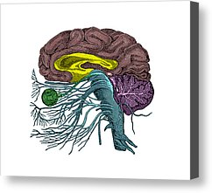
Sequential Development
Early & Middle
Early
Hippocampus & Amygdala
Memory, Learning, Response to Danger
Delayed Effects
Corpus Collosum
Language
Math
Integration of Creative & Analytical Thought
Infant Neglect, Sexual Abuse 9-10
Middle
Into Adulthood
R. Temporal Gyrus
Spoken Language
Social Cognition
Profound Depression
Suicidality
Emotional Abuse, Including Bullying
Cortex
Thinking, Judgment, Long-Term Memory, Executive Function, Hope
Multiple Sensitive Periods
All, Family Violence 8-10, Sexual Abuse pre 12 & 15-16
Pre-Puberty
Cerebellar Vermis
Affect, Attention, Movement, Substance Abuse & Mental Health
Delayed Effects
Notes:
Hippocampus: all maltreatment early, sexual abuse 3-5
Corpus Collosum: neglect in Infancy, sexual abuse middle
Cerebellar Vermis: all maltreatment
Cortex: All maltreatment prenatal to age 3; Witnessing family violence ages 8-10; Sexual abuse prior to age 12 affecting visual cortex
Sexual abuse at 15-16 affecting executive function

Slide 4

Challenges with Behavioral Control
Poor modulation of impulses
Self-destructive behavior
Risk-taking behavior
Aggression towards others
Self-mutilation, oppositional or antisocial behavior
Victimization
Difficulty with rule compliance & social cues
Limited perception of cause-and-effect consequences

Slide 5

Each Person: A Unique Experience of the World

Slide 6
Adverse Childhood Experiences Study
Largest Study of its Kind
Over 17,000 participants
Both Retrospective and Prospective
Over 100 Peer-Reviewed Journal Articles
Shifting the Paradigm
Helps Us Understand Drivers of Population Health
Notes:
We have been talking about neuroscience research – which is the study of individuals. Now we are going to switch gears and talk about the population as a whole. It can be challenging to think about how the whole population is affected by a disease agent – but when we are interested in transformational change – really finding high leverage solutions to problems, then we need to think about what would produce population-level improvements. So, we’ll turn to the field of epidemiology.
When Dr. Rob Anda and Dr. Vincent Felitti designed the ACE Study, they were testing a theory about pathways to disease. They were studying disease agents that would change the way we think about preventive action. They thought about the impact of life experiences during childhood on human development and how health changes over the lifespan. They used a life-span perspective to develop this theoretical model for learning about foundations of health, safety, and long life.
Their theory was that adverse childhood experience leads to social, emotional, cognitive impairment, which leads to adoptions of risk behaviors, which leads to disease and early death. They designed the ACE study to determine whether or not adverse childhood experience could be an underlying cause of a portion of diseases experienced in the population.
Prior to this work Dr. Anda had been a leader in the field of reducing heart disease. His work through the 80s and into the 90s, was about identifying risk and protective factors that predicted heart disease, and working to reduce the risk and increase the protective factors. You all will recognize this risk and protective model – it has been the prevailing model for prevention in many fields during our lives. But, Dr. Anda knew that risk for heart disease as will as risk for many mental, physical, and behavioral disorders is not randomly distributed – and therefore could not be the underlying cause of the health problems he was dedicated to resolving. Prior to the ACE study, Dr Anda won many prestigious awards for his work leading primary, secondary and tertiary disease reduction strategies using a risk and protection factor approach, but he left that behind in order to find underlying causes of ill-health.
This pioneering and courageous work by Drs. Felitti and Anda uncovered evidence of the most powerful determinate of the public’s health. It also challenged long held beliefs about pathways to disease and theories about how best to interrupt them. The work was, at first, controversial. Now, it leads strategy at the World Health Organization, many federal agencies, and here in Washington – in state agencies and in communities throughout the state.

Slide 7
Early
Death
Disease, Disability & Social Problems
Adoption of Health Risk Behaviors
Disrupted Social, Emotional, Cognitive Development
Adverse Childhood Experiences
Death
Life Course Perspective
Neurodevelopment
Epigenetics
Conception

Slide 8
ACE Categories Considered in the Study
Indicators of Family Dysfunction
Mentally ill, depressed or suicidal person in home
Drug addicted or alcoholic family member
Parental discord – indicated by divorce, separation, abandonment
Witnessing domestic violence against the mother
Incarceration of any family member
Abuse
Child physical abuse
Child sexual abuse
Child emotional abuse
Neglect
Physical Neglect
Emotional Neglect
Notes:
The Adverse Childhood Experience categories that Drs Anda and Felitti included in their study include :
Three forms of abuse: physical, emotional, and sexual abuse
Two kinds of neglect: physical and emotional neglect and
Five indicators of household functioning: having a mentally ill, depressed or suicidal person in the home, having a drug addicted or alcoholic family member, incarceration of a family member, loss of a parent, and witnessing violence against one’s mother.
The researchers did ask about severity of abuse, duration and other kinds of questions that are important to folks working in child safety. But when it comes to health outcomes, they found that what matters most in terms of life-long health is the number of different kinds of adverse childhood experiences. When lots of different categories stack up in a person’s life, the cumulative effective is stunning.
And, these different kinds of experiences do typically come in clusters – among people who said that they had one category of Adverse Childhood Experience, 87% had at least one more category of Adverse Childhood Experience. So, the researchers said “It doesn’t make sense to make a study about the 13% who don’t have additional ACEs, it makes more sense to have the study be about the 87% of people who did experience multiple ACE categories.
That’s why they made an ACE score – which you will see throughout the rest of this presentation. The ACE Score is the number of different categories of Adverse Experience during a person’s childhood – from 1-10.

Slide 9
ACE Categories are Interrelated
87%
with 1 ACE
Have Another
ACEs Have Cumulative Effect: ACE Score = Number of Categories of ACEs (1-10)

Slide 10
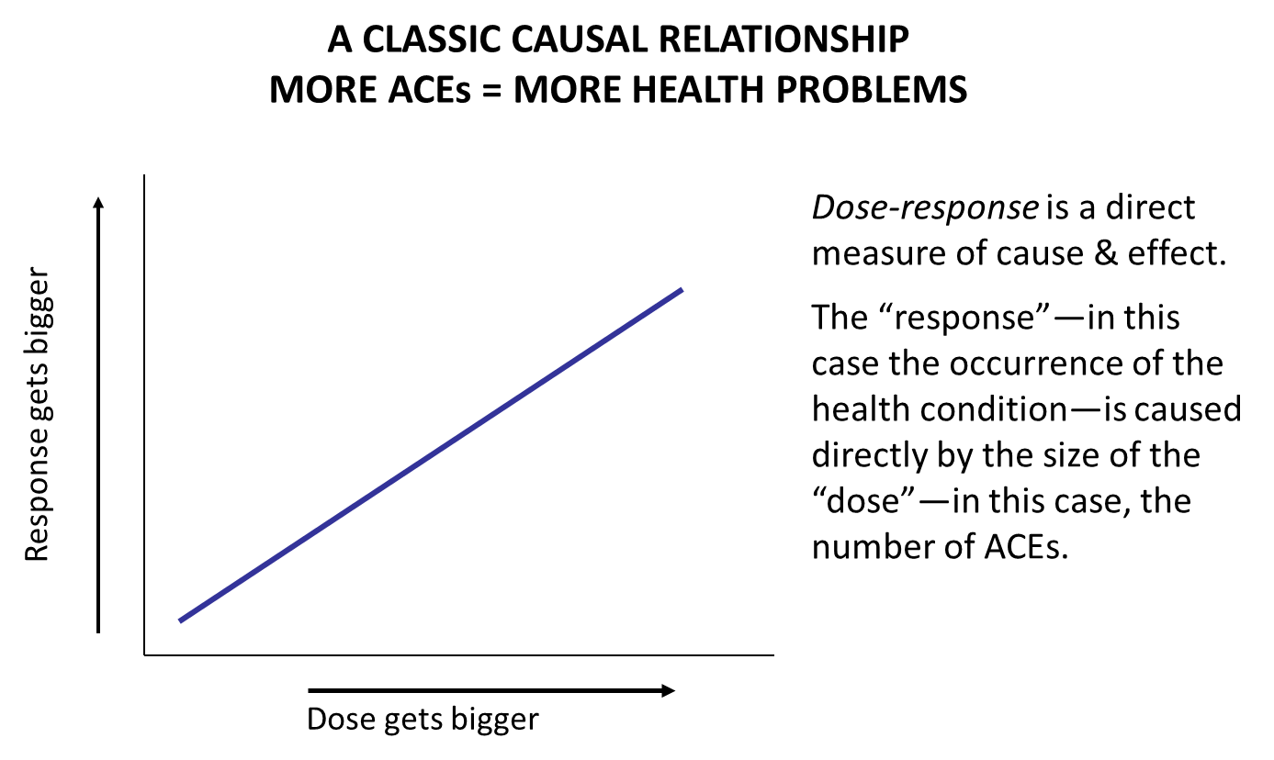
Strong Graded Relationship
More ACEs: More Risk

Slide 11
Risk for Disease
Attributable to ACEs
Smoking
Heavy Drinking
Binge Drinking
Drinking and Driving
Had a Drug Problem
Addicted to Drugs
Ever Injected Drugs
Original ACE Study
Notes:
These charts show the dose-response relationship between higher ACE categories and various kinds of risks for health problems. These charts are all read the same way. I’ll walk you through the top chart on current smoking in Washington, and then you will recognize that same stair-stepped pattern in the rest of the ACE findings slides.
The vertical access in the smoking chart is the percent of the population with the disease or condition – in this case current smoking. Along the horizontal access, from left to right are the number of ACE categories reported: on the far left you see the group of people who reported “zero” ACEs, then the group who reported “one” Ace, and so on to the group represented on the far right who reported having an ACE score of 6, 7 or 8.
Among people who reported 0 ACE categories, 10.4% currently smoke; among people who reported 6, 7 or 8 ACE categories, 28.5% currently smoke. The higher the ACE “dose” the greater the probability of current smoking. That is what we mean by a dose-response relationship between ACEs and mental, physical and behavioral health problems. We see that same dose-response pattern for people reporting that they have ever had a drug problem, and if we had more time, I could show you this same pattern for heavy drinking, binge drinking, drinking and driving, drug addiction and injection of drugs.

Slide 12
Chronic Disease
Attributable to ACEs
Notes:
And here we see the relationship between ACEs and chronic disease.
People with an ACE Score of 6 to 8 are 1 & ¾ times more likely to have cardiovascular disease than people with zero ACEs.
And, for Asthma, we can see that only 1.3% of people reporting an ACE score of 0 have asthma; as compared with 12 % of people with an ACE score of 5 or more having asthma. So, people with high ACE scores are ten times more likely to have asthma than people with an ACE score of zero.
And, if we were to look at more charts about ACEs and chronic disease, we would see the same pattern: the higher the ACE score, the higher the percent of people suffering from cancer, diabetes, auto immune disease, COPD, Ischemic heart disease, and liver disease.

Slide 13
Mental Illness
Attributable to ACEs
Depression
Serious & persistent mental illness
Frequent mental distress
Nervousness
Suicide attempts
Emotional problems restrict activities
Notes:
And, here we can see the relationship between ACEs and mental health.
Whether we consider depression, mental distress, nervousness, serious and persistent mental illness, suicide problems or challenges that restrict people’s daily lives, we see the same stair-stepped pattern – the higher the ACE score, the higher the odds of mental health challenge.

Slide 14
ACEs & History of Homelessness
2010 BRFSS – Preliminary; Based on < Full Year of Data
Notes:
Documentation/notes for
Two charts on ACEs and History of Homelessness since the Age of 18
General Washington State Adult Population
Source: Washington State 2010 BRFSS: n = 5,960 - representing 5.1 million adults
Total Result: 5.6 % adults (18 year old or more) had a history of homelessness -
They represent 290,000 Washington State adults
Number of ACEs: 0 1 2 3 4-5 6-8
% of total adults: 37.4 21.9 13.7 9.8 12.0 5.2
N of adults in thousands: 1,926 1,128 705 505 618 268
Sample sizes: n= 2,313 1,345 811 528 673 290
25-54 Year Old Adults in Washington State
Source: Washington State 2010 BRFSS: n = 2,260 - representing 2.8 million adults
Total Result: 7.9 % adults 25-54 year old had a history of homelessness since the age of 18 – They represent 225,000 Washington State adults
Number of ACEs: 0 1 2 3 4-5 6-8
% of total adults: 33.8 22.0 13.8 9.8 13.9 6.7
N of adults in thousands: 1,926 1,128 705 505 618 268
Sample sizes: n= 958 624 391 275 394 190
Tables drawn from:
H:\BRFSS\2010\homeless\preliminary homeless frequencies and ACEs 8_30_2011.spv
Dr. Dario Longhi, Ph. D. 9-30-11

Slide 15
ACEs are Common
62% have ≥1
26.5% ≥ 3
5% ≥ 6
ACE & Population Health in Washington; Anda & Brown; 2009
Notes:
In Washington, we only could survey adults about 8 of the ACEs, so the ACE score in the Washington data is a score of 0 to 8 ACEs. We weren’t able to ask about child neglect because the questions developed by the CDC about neglect didn’t make it through their rigorous testing process. In Washington, ACEs are common – in fact they are almost exactly as common as they were in the initial study population. 62% of Washington adults have an ACE score of 1 or more; 26% have an ACE score of 3 or more; and, 5% have an ACE score of 6 to 8.
The news that ACEs are this common can be hard to hear, for a variety of reasons. We all know people who have struggled with adverse experiences. What does it really mean when we say “ACEs are common?” It means that the majority of us sitting here today have a personal experience with ACEs. With 60% of Washingtonians reporting one or more of these experiences, the data can really hit home.
Many thousands of Washingtonians have seen this Power Point- or a similar one. Some people have been very deeply touched by the data—moved to tears, even. And that’s really okay. I want you to know that many of those folks have said afterwards that they feel liberated. They will often say: “Oh, these things in my life are connected. My life is hard for some very good reasons.”
Some people have asked if there are other ACEs. The answer is “probably yes”. These nine types of experience are proxy for toxic stress – the kind that creates elevated stress hormones for prolonged periods of time – through critical or sensitive developmental periods. Some researchers refer to the type of stress that causes stress hormones and neurotransmitters to be released and to remain at high levels for long periods of time Toxic Stress; others call this phenomenon Complex Trauma.

Slide 16
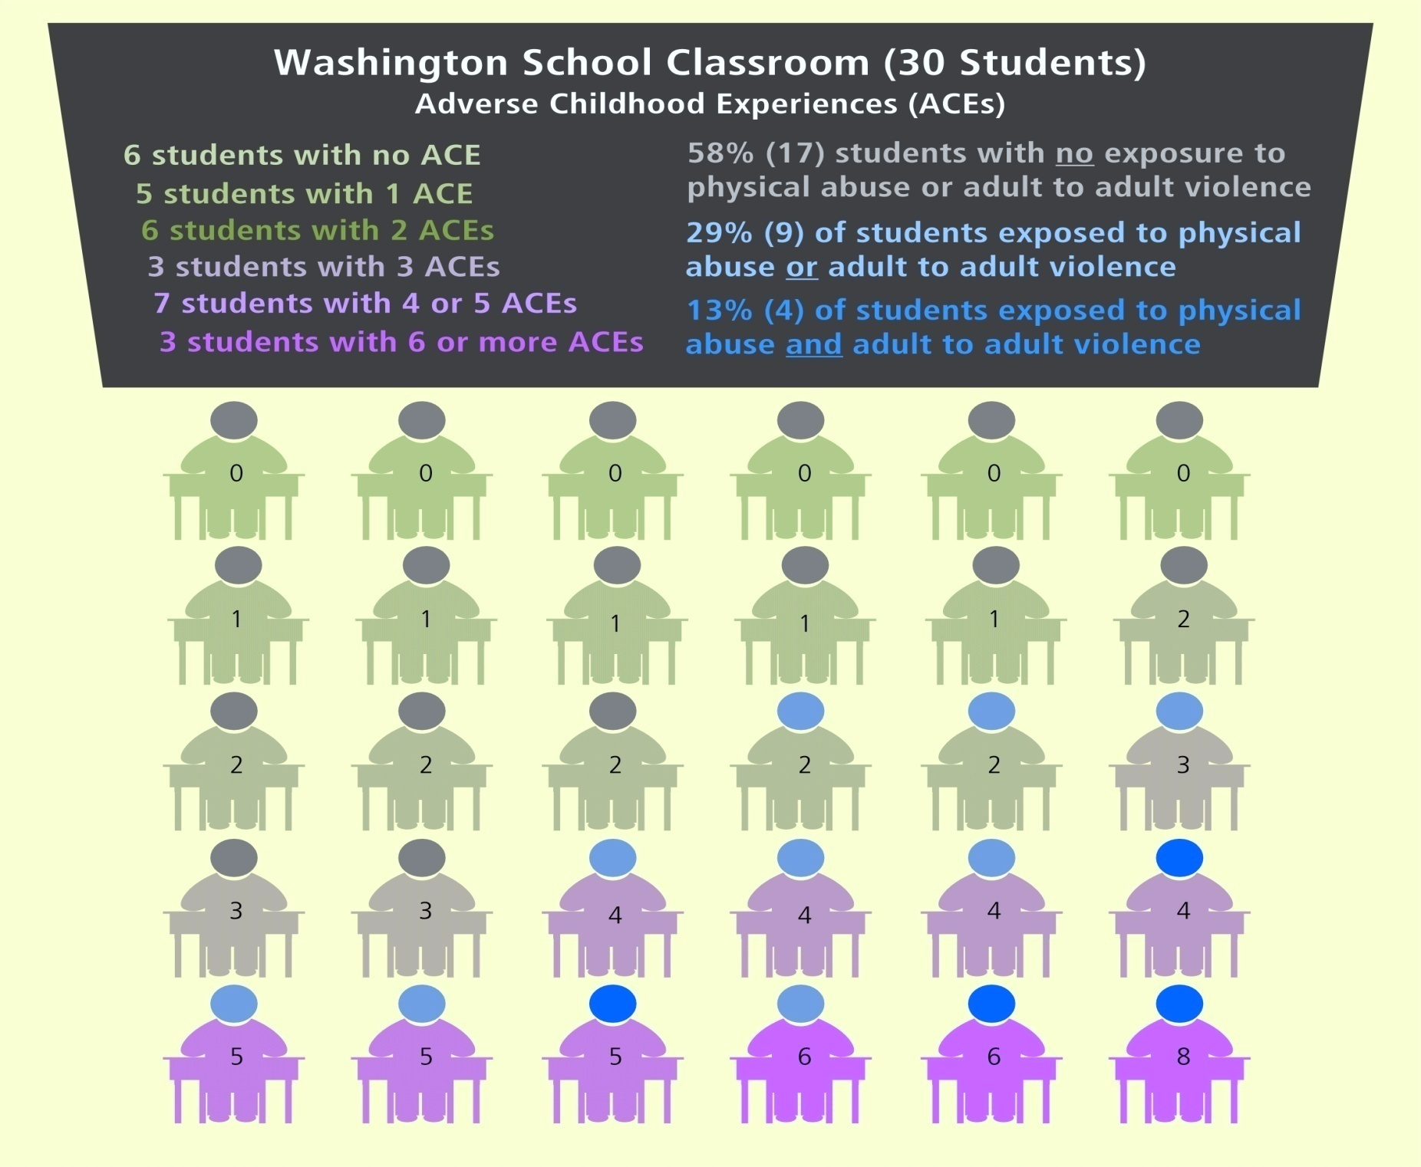
Population
Average- 10th Grade
42% ≥ 3 ACEs
10% ≥ 6 ACEs
Notes:
Based on interpolation of Healthy Youth Survey data from Behavioral Risk Factor Surveillance System data, we are able to learn about the ACE scores of high school youth in an average classroom in Washington.
The punch line here is that 42% of high school sophomores and seniors have 3 or more ACEs; whereas 26% of adults in Washington have 3 or more ACEs.
This reality indicates that we, as a society, are failing to protect and prevent toxic stress in the lives of children. We can say it’s the parent’s fault, or the government’s fault… but we also must face that we are the adults alive today. We are somehow participating in a social dynamic that results in 42% of teens having 3 or more ACEs.
We are the ones that must change these social dynamics, and we absolutely can do that… communities in Washington are already having success.

Slide 17
Enduring Effects
What’s Wrong With Me, That My Life Feels So hard?
COGNITIVE
SOCIAL
MENTAL HEALTH
SUBSTANCE ABUSE
PHYSICAL AGILITY
SAFETY & VULNERABILITY
CHRONIC DISEASE
PRODUCTIVITY
ADULT CRISIS – HOMELESSNESS, INCARCERATION, POVERTY
It’s Not What’s Wrong With You; It’s What Happened to You….
Notes:
We can’t erase the biological effects of toxic stress - at least no one knows how to do that yet. But, we can challenge our own thinking about the origins of social and relational problems. We can intentionally notice when people are having difficulty picking up social cues, for example, and develop a habit of saying in words what we might have signaled through body language.
We can challenge belief that a child who is acting aggressively is defiant, and instead work to channel emotional reactions by teaching skills. People who learn to reflect on their own emotional state, and make quick decisions about whether or not they can stay in a situation gain two important benefits: through reflection one “Lights-up” a different part of the brain and activates an alternative channel for self regulation; and, over time using the brain in this new way supports development of new skills of quick and decisive leadership.
And, as we recognize the enduring effects of toxic stress during development, we can reach to effective educational programs about how to navigate chronic health challenges. One basic skill is to recognize that the condition itself may not need to be eliminated in order to bring joy and fulfillment into life. For many people, restoring a sense of belonging goes a long ways to help. If chronic disease limits the amount of time that can be spent in social endeavors, for example, community organized café’ dialogues can provide drop-in opportunities for conversation that don’t require every individual to have the energy to host. Community can make a big difference.

Slide 18
Adult Adversity
Incarceration
Victim: Intimate Partner Violence
Drug/Alcohol
Mental Illness
Divorce
Parenting Adults
with ≥5 ACE
14 TIMES
more likely to have
two or more conditions
that make
ACEs for kids
Court-Involved Youth
Higher ACE Scores
Among those with ≥4:
51% special ed.
(vs. 33% 0-1)
74% below 2.0 GPA (58%)
85% suspended by 2nd (71%)
33% re-offend in 2 years (13%)
High School Youth
42% ≥ 3 ACEs
Elementary Children
12% ≥ 3 ACEs
1. Health, attendance, behavior
2. Academic failure
Work injury- illness
Homelessness
Disability
Poverty
Health limits activity
Unemployment

Slide 19
Adult Adversity Compounds Effects
Adults with ≥3 ACEs
Plus
Major Stress Categories:
Homelessness
Incarceration
Chronic illness
Separation/Divorce
Severe Depression
Work-related Injury/ Illness
Notes:
Adult adverse experience interacts with the impacts of Adverse Childhood Experience.
The combination results in more complex symptoms, which are reflected in increased disability score. This chart provides information about adults with 3 or more ACEs. Having a higher ACE score increases the likelihood of adult adversities, including the categories considered in this chart
Homelessness
Incarceration
Chronic illness
Separation/Divorce
Severe Depression
Work-related Injury/ Illness
adversity Eighty percent (80%) of the population of adults who have a high ACE score plus a large number of categories report interruption in their ability to do their usual activities, including work for one or more days a month. Forty percent (40%) report disability-related interruption to their daily activities for 14 to 29 days a month (Moderate Disability Score).

Slide 20
Generational & Life Course Perspective
“Judges often see adults raise new generations who appear in court – the outcome of the uninterrupted, intergenerational transmission of traumatic stress.”
National Child Traumatic Stress Network, Justice Consortium
Understand Commit Practice

Slide 21

Understand
Prevalence and consequences of developmental adversity
Whole person in context - personal and cultural history, meaning making, relationships, community
Vital Element for Effective Approach - Safety
  Strengths Based & Relationship Centered
  Collaborative Partnership Approach
  Consistent with Self-Direction, Shared Power
Recovery is possible; people most affected become leaders of self-healing families and communities
Hyper-arousal can look like misbehavior or bad temper.

Slide 22
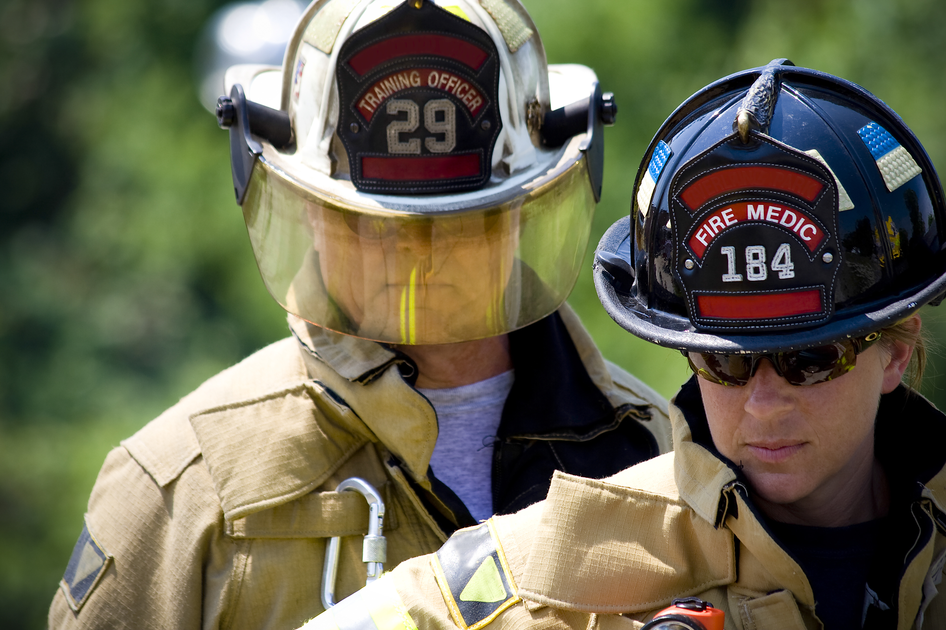
Commit
Safe environment & transitions (physical and relational)
Staff training, coaching, reflection time (including scripts)
Implement trauma-sensitive hiring practices & evaluations Consider the “fit” between employee skills and needs of trauma-impacted customers
Leadership: enhance community system of trauma informed care; support training for first responders in trauma-sensitive handling and arrest methods; minimize use of seclusion and restraints
Invest in systematic learning to inform continuous improvement

Slide 23

Practice
Increase transparency: processes, transitions
Employ universal precautions – clearly articulate expectations for assessment of ACE/trauma; attend to prevention of secondary trauma and support reflective practice among professionals
Focus on choice & empowerment vs. control; build on strengths, promote resilience, honor culture
Structure time and interactions to deepen relationships, improve feelings of safety, reduce exposure to traumatic reminders and unnecessary stress
Order trauma informed treatment & support peer recovery systems

Slide 24
Court Trauma Audits
Themes from Initial Findings
Make efforts to limit unnecessary physiological arousal (stress) that can result from crowded waiting areas, high levels of noise, and long wait times.
Install clear and plain language signage -- in multiple languages – to help court consumers navigate an oftentimes confusing maze of offices, courtrooms, and resource windows/desks.
National Council of Juvenile and Family Court Judges

Slide 25
…Court Trauma Audit Themes
Separate waiting areas for victims can help instill a sense of safety for court consumers, but are often lacking or nonexistent in many courts.
Employee assistance programs or informal support groups for staff working in juvenile and family courts to reduce effects of are substantial stress exposure
Align policy and practice & make every effort to offer consumers voice and choice in proceedings should be made within the confines of security needs, the law, etc.
National Council of Juvenile and Family Court Judges

Slide 26
Three Systems for Promoting Resilience
Capabilities
Attachment & Belonging
Community, Culture, Spirituality
“Nurturing the healthy development of these protective systems affords the most important preparation or ‘inoculation’ for overcoming potential threats and adversities in human development. Similarly, damage or destruction of these systems has dire consequences for the positive adaptive capacity of individuals.” Ann Masten, 2009
Notes:
Community, culture and spirituality provide human beings with belonging, faith, hope, and a sense of meaning.
Some people feel a sense of community with the people around them; others from their cultural heritage. For some, a sense of belonging comes more from their connection to a place, or a set of beliefs. Together, all of these strengths come together in community.
Communities are complex adaptive systems – every individual impacts the community as a whole; and the whole community also influences the life of each and every individual. When communities have healthy processes and organizations, it’s like a rising tide – a rising tide that lifts all people.
Being a resilient community isn’t something that “Just happens” – it’s a continuous process of connecting and re-connecting people, ideas, resources, and hope. Communities can develop rituals of connection – using regular gatherings to build social networks that will be in place during good times and bad.

Slide 27
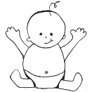
Many systems are investing in ACE education and trauma informed practice. What is the role of courts in the context of state-wide change?
What are the high-leverage actions that courts appropriately can lead?
What court practices represent “next steps”?
Powerful Strategy
Moderate ACE Effects
Among Parenting Adults
Prevent High ACE Scores among Children
8
7
2
Mutually Reinforcing
Notes:
We’ve all heard the phrase “breaking the cycle”… sometimes it is used when people talk about child abuse or violence. We can think in those terms when we think about preventing ACEs.
When parents struggle with daily parenting tasks due to the effects of their own ACEs, a little help and support may go a long way toward keeping their family safe, healthy and together.
Our support for parents with high ACE scores can potentially improve their daily functioning and the functioning of their families. So, one strategic focus of our efforts could be helping parenting adults in their work and family lives.
As parents, with the help of their circle of friends and neighbors succeed, they are more likely to be able to prevent the accumulation of ACEs in the lives of their children. And, as ACE scores among children go down, and those children grow to become parents – we’ll see fewer ACE-related challenges for the next generation of parents. So, we set up a reinforcing cycle for the good.
Instead of “breaking the cycle” we might think about “making the cycle” of ACE prevention. This would be a powerful cycle for the good – one that is sustainable because success with one generation leads to success with the next. Instead of spiraling down, we would spiral up… isn’t that where we want to be.

Slide 28
What Helps Individuals Self-regulate?
Reflection, Biofeedback. Mindfulness
Massage
Movement and Music
Exercise & Play
Activities that integrate visual information with fine- and gross-motor movements (striking, kicking, and catching)
Physical activities for exploration of environment
Practicing connection
Capabilities

Slide 29
A Simple Tool from Lincoln High
Wait a Day
Wait an Hour
Ready to Talk

Slide 30
What Generates Belonging & Support?
Developing ceremonies or rituals
Including others in health-promoting activities
Engaging in multiple family or whole community/workplace dialogues
Setting up mutual support and/or helping systems
Creating art, movement, rhythm, music
Learning together
Attachment & Belonging

Slide 31

Poor Mental Health Days
& Feeling Supported, Satisfied, Hopeful

Slide 32
Poor Physical Health
& Feeling Supported, Satisfied, Hopeful

Slide 33
Experiencing Hope +
At Least Two People Who Help

Slide 34
Poor Mental Health Days
& Experiencing Help & Hope

Slide 35
Poor Physical Health Days
& Experiencing Help & Hope

Slide 36
Ability to Work
& Experiencing Help & Hope

Slide 37
Building Self-Healing Communities
Other Special Services
Community
Services
Population
Affected
by ACEs
Justice
System
Education
System
© 2013

Slide 38
Layer Up
Strengths in All Three Resilience Factors: Population-Level Impacts
Feeling socially & emotionally supported, satisfied with life and hopeful
Experiencing hope plus two or more people who give concrete help when needed
Community reciprocity in watching out for children, intervening when they are in trouble, doing favors for one another, reaching outside social groups to get help for friends.

Slide 39
Community Reciprocity
Watching out for children,
Intervening when they are in trouble,
Doing favors for one another
Reaching outside friendship circle to seek help for friends
A Rising Tide Lifts All Boats
Mental Illness
Obesity
Alcohol consumption
Physical activity meeting recommended levels

Slide 40
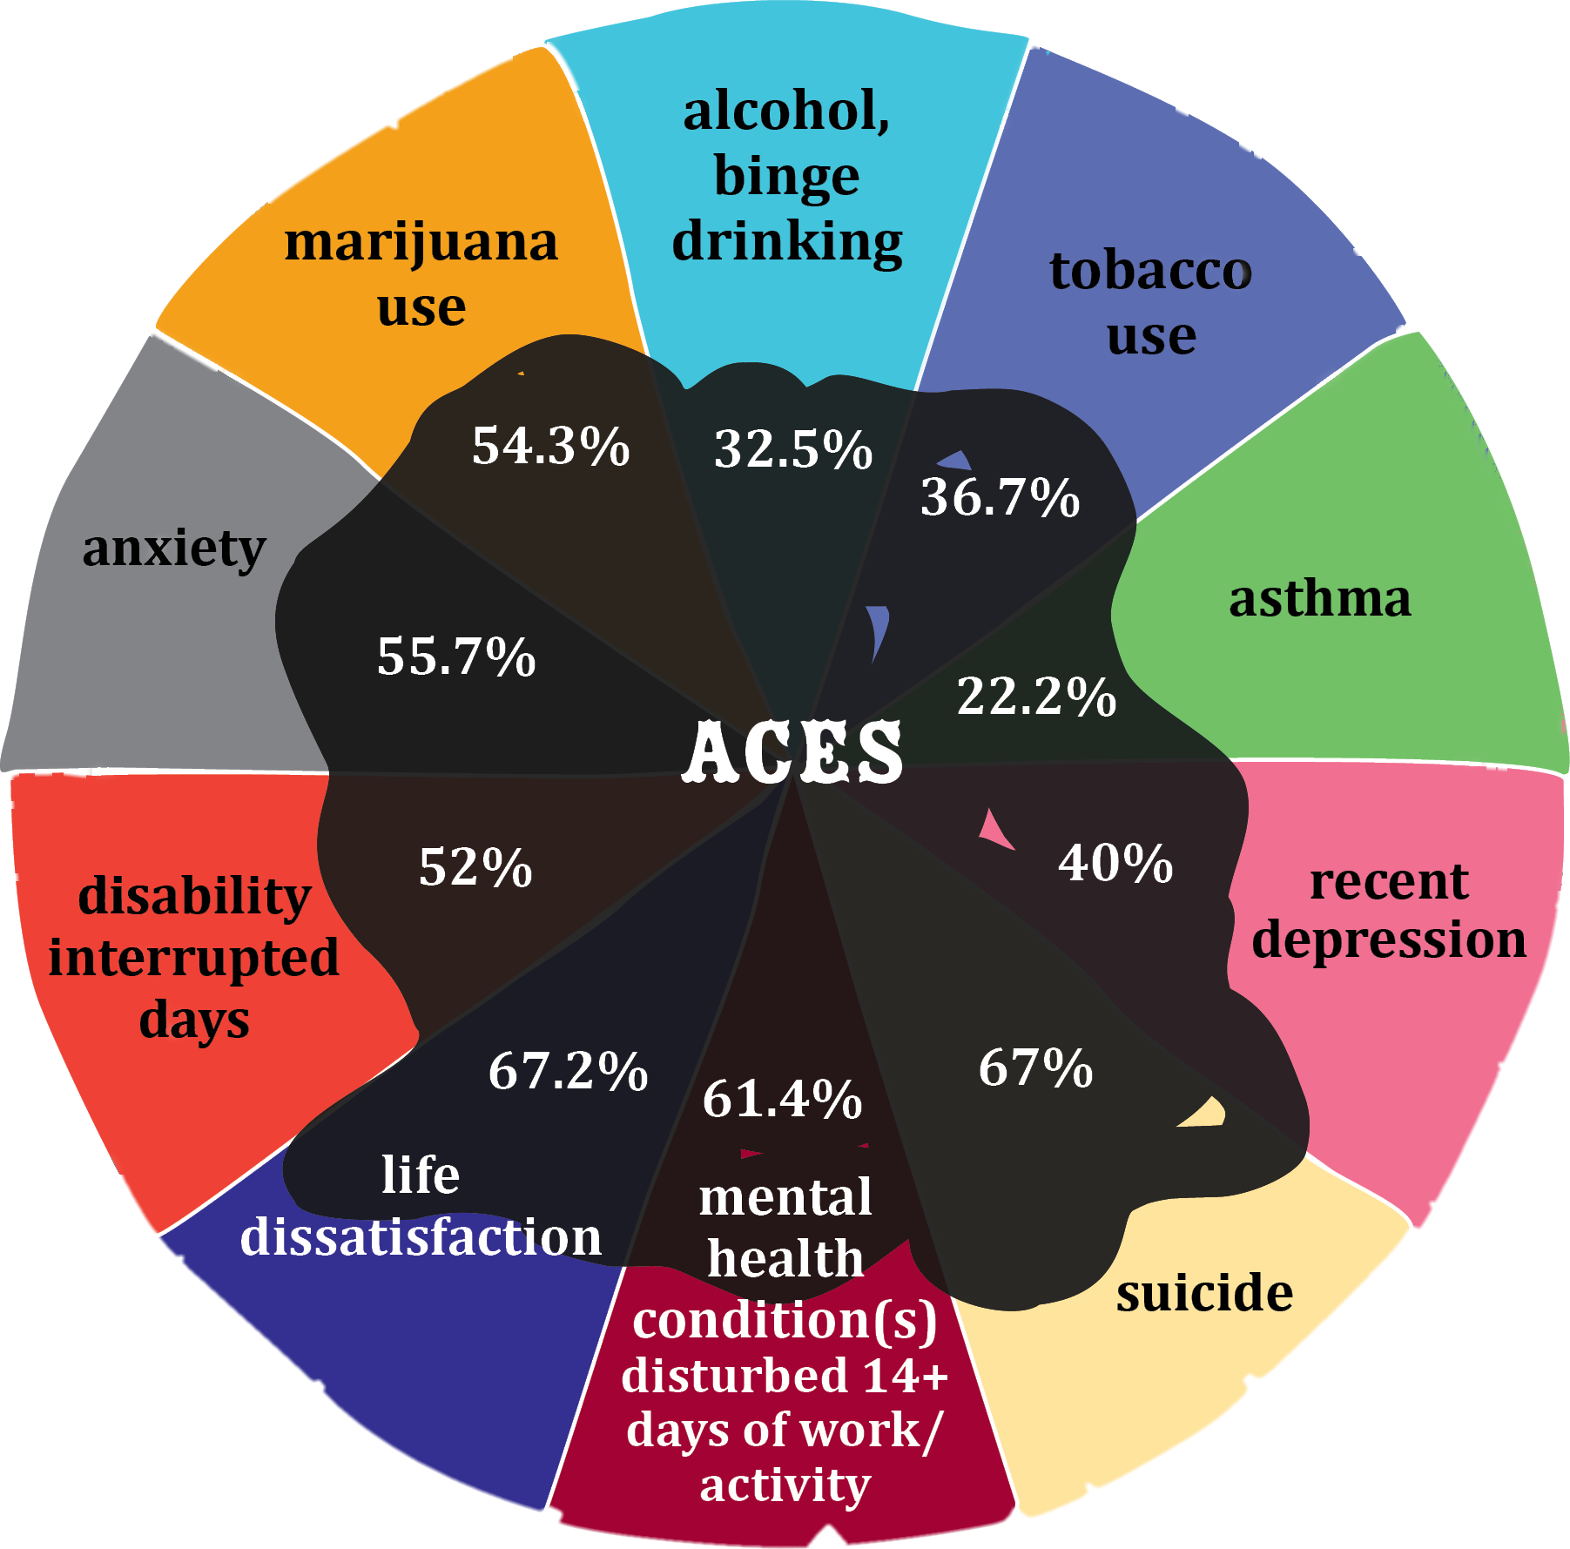
The Magnitude of the Solution
60% of
History of Incarceration
as an Adult
is Attributable to ACES.
Population Attributable Risk
for ACE–related problems ranges from 20% to 80%

